Slide 1


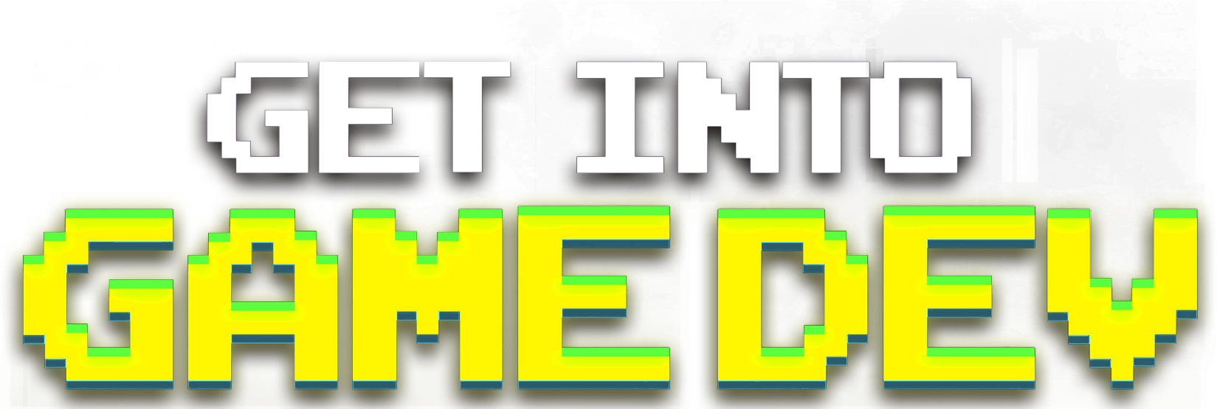

Crafting Bespoke
Resumes & Portfolios
with Matthew Ventures
Notes:
Presentation Tips:
- Address peers
- Take breaths
Hi folks, welcome to Get into Game Dev: Crafting a Resume and Portfolio. In this talk we’ll be discussing how to find a role and give you the best chance at landing it. Before we get started I'd like to ask you to please silence your cell phones and of course fill out the survey information.
Photo Credit:
https://stock.adobe.com/images/mountaineers-help-each-other-to-reach-the-summit/254270160?prev_url=detail

Slide 2

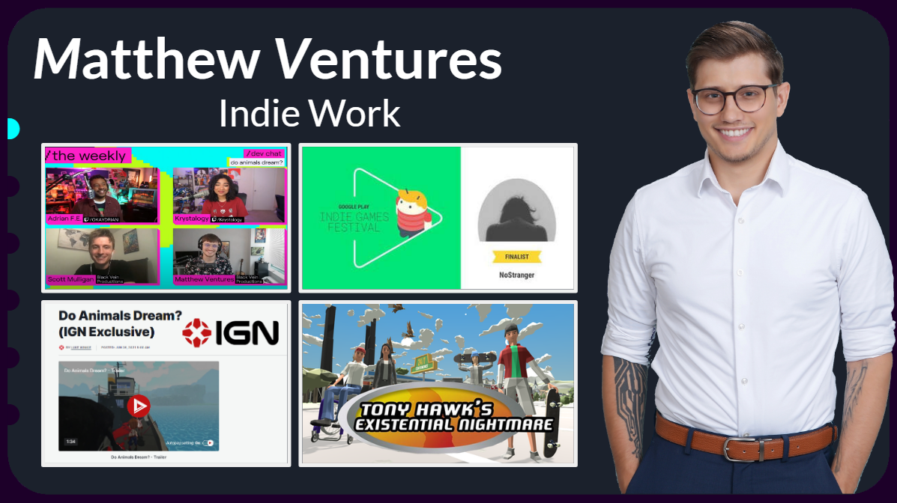



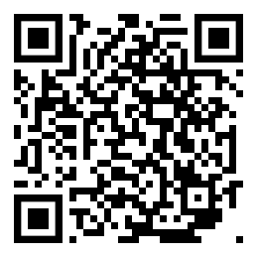
Slides available
online!
mrventures.net/get-into-gamedev
Notes:
I talk fast. But you can go through the slides at your leisure. Including lots bonus slides. These slides are available right now! At this link:
mrventures.net/get-into-gamedev. There’s a QR code in the corner.
Photo Credit:
https://www.istockphoto.com/vector/red-arrow-icon-on-white-background-flat-style-arrow-icon-for-your-web-site-design-gm1135222849-301926076

Slide 3

Roadmap
● Speaker Bio
● Roles
● Job Search
● Job Post Analysis
● Resumes
● Portfolios
Notes:
Here’s the plan for today. I’ll do a brief intro, and then we’ll talk all about you, the companies you want to work at, the roles you want to apply to, and finally how to make a resume and portfolio for those roles.
Photo Credit:
https://demri.net/about-us/142-foundational-documents/788-demri-roadmap

Slide 4

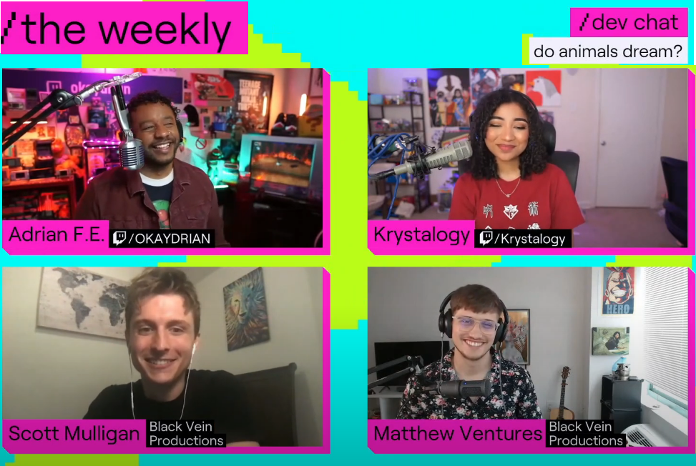

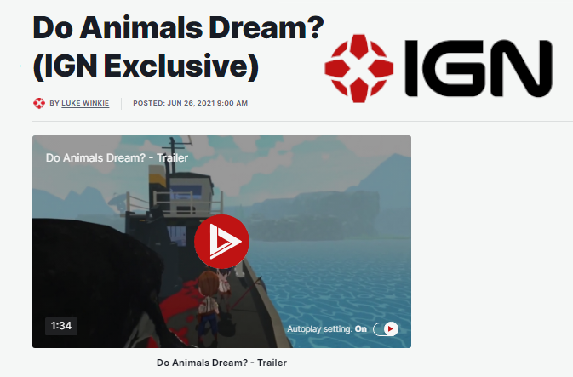
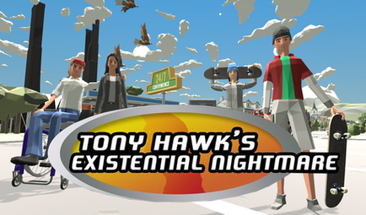
Matthew Ventures
●
●
●
●
●
●
Indie Work
Notes:
00:45 - I’m Matthew Ventures, I started an indie games company back in college and we have made a wide variety of indie games which have been recognized by folks like IGN and the Google Indie Games Festival.

Slide 5

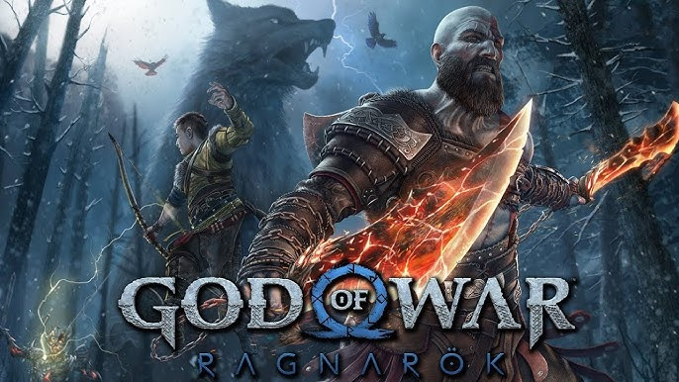
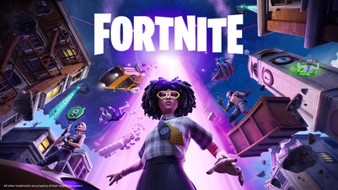
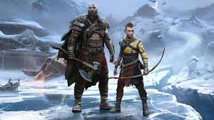


Matthew Ventures
●
●
●
●
●
●
AAA Work
Notes:
Over the last ten years, I've also worked on some larger games franchises like Call of Duty, God of War, and Fortnite which have recieved various awards as well.

Slide 6
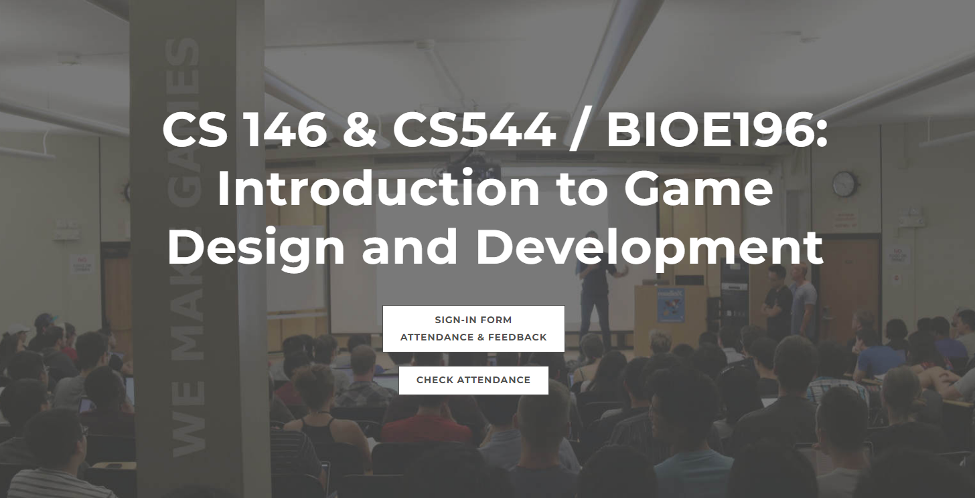


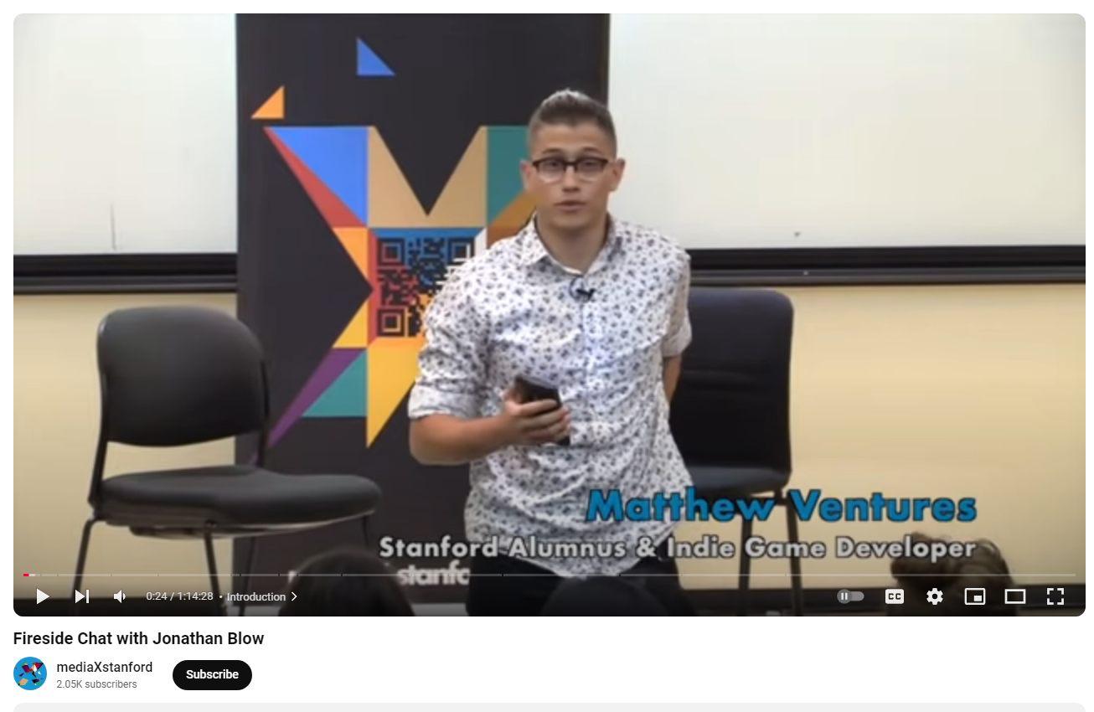
Matthew Ventures
●
●
●
●
●
●
Education Work
Notes:
But what I’m most proud of is teaching. I taught intro to game dev at Stanford for a few years.

Slide 7
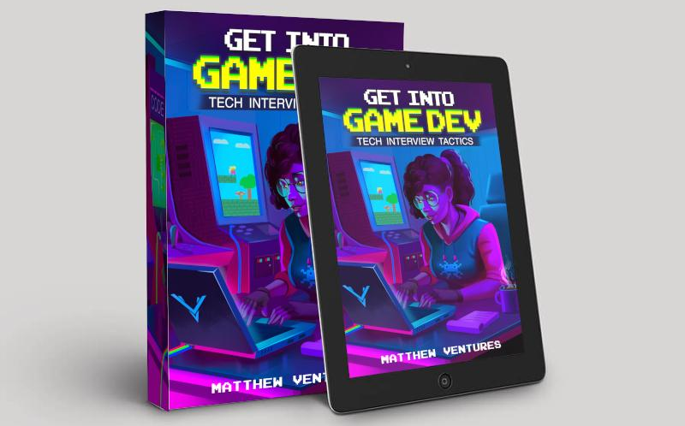
Matthew Ventures
●
●
●
●
●
●
Education Work
Notes:
I also wrote a book which is published by GDC’s parent company, and freelance as a career coach. AND All the proceeds of this work, I donate to charity. I care a lot about growing this community, and providing resources that I wish I had when I was getting started.
Many of the folks I help are trying to get their first an internship. That’s something I know a lot about, I actually did more than TEN internships myself. But I work with people at all levels of their career.
So while today we will cover some topics for students, and some topics for coders, are focus is on the fundamentals relevant to everyone.

Slide 8

Let’s
do this
together!
Notes:
Okay and let’s be honest, this industry is going through a difficult time.
Now more than ever we need to come together as a community to support each other and share resources so that we rebuild.
Photo Credit:
https://www.sfu.ca/content/sfu/sfunews/stories/2021/07/imagining-wellness-in-a-post-covid-world--sfu-brings-together-gl/jcr:content/main_content/image.img.640.medium.jpg/1625787761659.jpg

Slide 9
Roadmap
● Speaker Bio
● Roles
● Job Search
● Job Post Analysis
● Resumes
● Portfolios
Notes:
01:45 - Now before we get into it… I want to address… TWO common misunderstanding.
Photo Credit:
https://demri.net/about-us/142-foundational-documents/788-demri-roadmap

Slide 10

Just a numbers game?
●
●
●
●
●
●
Notes:
The first misunderstanding is that job applications are “JUST a numbers game”.
Photo Credit:
https://www.alamy.com/stock-photo-poker-chip-collection-stacked-76830486.html

Slide 11

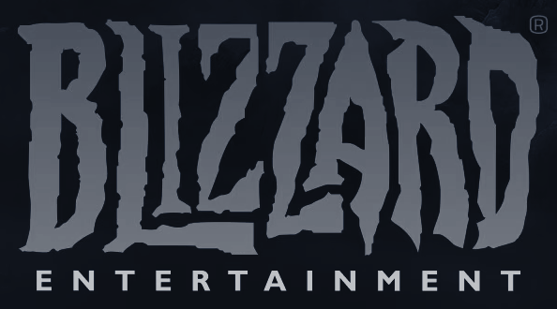

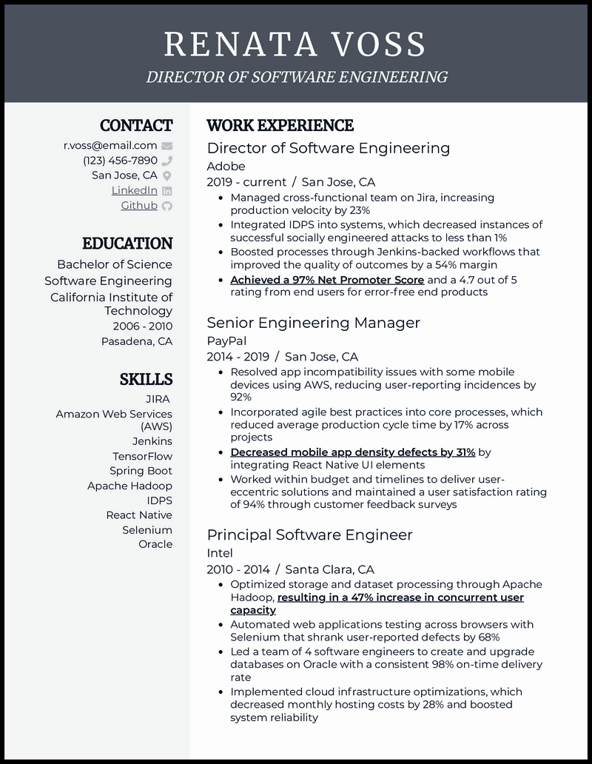



Just a numbers game?
●
●
●
●
●
●
Notes:
Well if you send your resume to 100 companies and get zero interviews, then that means we need to improve the candidacy.
Sending out another 100 applications is not going to fix the underlying issues.
Photo Credit:
https://www.alamy.com/stock-photo-poker-chip-collection-stacked-76830486.html
https://oag.ca.gov/sites/default/files/career-job-vacancies-img.jpg
https://cdn2.vectorstock.com/i/1000x1000/13/71/job-interview-young-cartoon-woman-candidate-vector-19921371.jpg

Slide 12
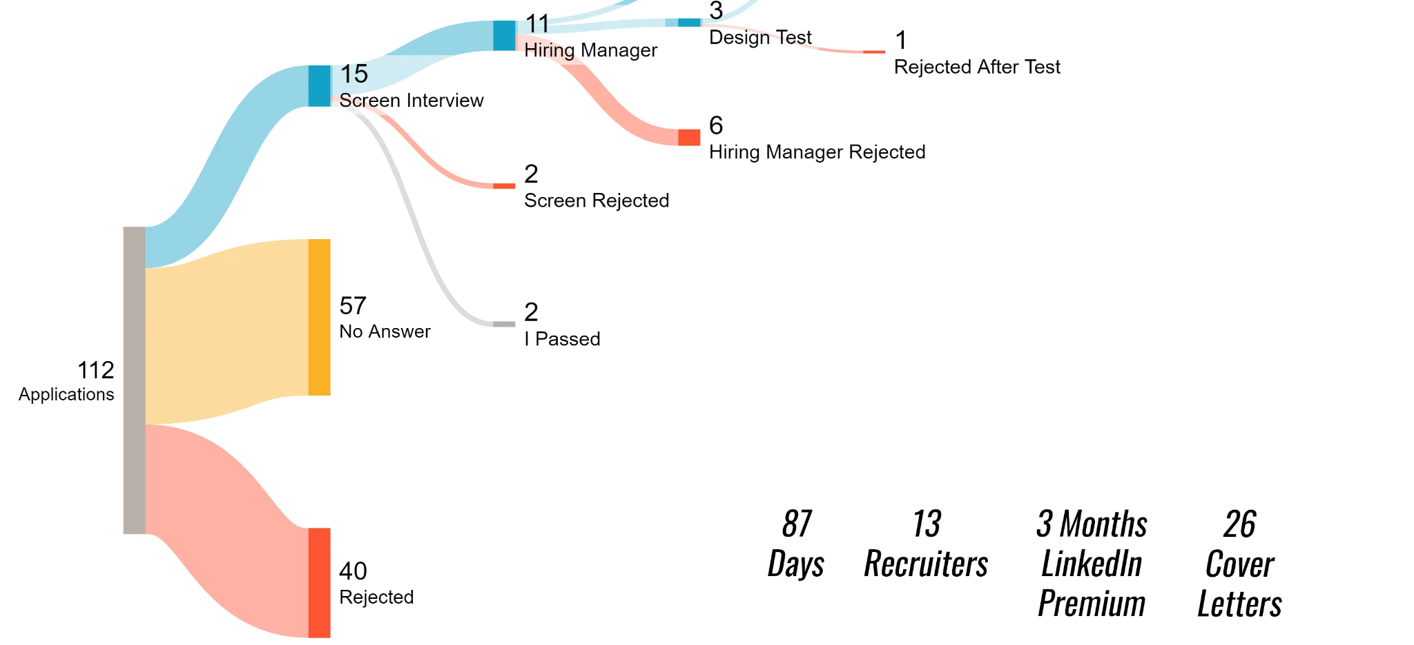
Just a numbers game?
●
●
●
●
●
●
112 Applications
15 Interviews
>10%
Notes:
A typical candidate story looks like this…
In three months: 100 application led to 15 interviews. That’s over 10%. That’s pretty good. It tells us we can do better, sure. But it means we’re getting to the next round.
So ONCE you reach this stage, and your candidacy is getting some traction -- even just 10% -- THEN applying to more jobs is going to help. But until then, just applying to more jobs is probably not enough.
We have to fix the response rate first.
Photo Credit:
https://www.reddit.com/r/dataisbeautiful/comments/1cgjkhk/job_hunting_in_the_game_industry_18_months_apart/

Slide 13

Just a numbers game?
●
●
●
●
●
●
Response Rate
Notes:
And that’s what this talk is about. Increasing that response rate: that’s where we are going to see the best results, regardless of how many applications we send.
Photo Credit:
https://www.finsyn.com/wp-content/uploads/2021/02/What-the-Heck-is-a-Stonk.png

Slide 14

Do I have to be Creative?
●
●
●
●
●
●
Notes:
Misunderstanding #2 is that it’s all about how creative you are. Videogames ARE a form of art and many of my students worry that they’re not creative enough.
But I’m here to tell you that that creativity is NOT our focus. Our focus is on competency.
Photo Credit:
https://artificialpaintings.com/wp-content/uploads/2024/06/1823_Exploring_Abstract_Art_in_Video_Games.webp

Slide 15

Competency, Not Creativity
●
●
●
●
●
●
Notes:
Consider the game designer. A great designer is not just an “an idea generator” -- it doesn’t matter where the idea comes from -- a great designer is someone who can take an idea and then consider a game’s creative direction, artistic direction, and technical constraints to problem solve and make that idea work. It’s not their nebulous creativity…
Photo Credit:
https://www.istockphoto.com/illustrations/excited-inventor
https://st2.depositphotos.com/5794592/8917/v/450/depositphotos_89170040-stock-illustration-busy-business-people-working-hard.jpg

Slide 16

Competency, Not Creativity
●
●
●
●
●
●
Notes:
It’s their hard-skills competency! And that’s NOT ONLY what makes a great designer. That’s what makes a great developer. Okay, it’s true of all disciplines.
Competency, not creativity.
Competency is the foundation of your candidacy.
Photo Credit:
https://www.istockphoto.com/illustrations/excited-inventor
https://st2.depositphotos.com/5794592/8917/v/450/depositphotos_89170040-stock-illustration-busy-business-people-working-hard.jpg

Slide 17

Choosing ONE Role
●
●
●
●
●
●
Notes:
When we talk about competency in game development, there are many different roles to consider. AND it’s a common mistake for a particular candidate to try and go after multiple roles at once.
Photo Credit:
https://media.istockphoto.com/id/1128662901/photo/businessman-chooses-the-path-strategy.jpg?s=612x612&w=0&k=20&c=8Rzgwa45s9NdlRwVnMGT7_1DgdcSXvyUjE58J2m9XXE=

Slide 18
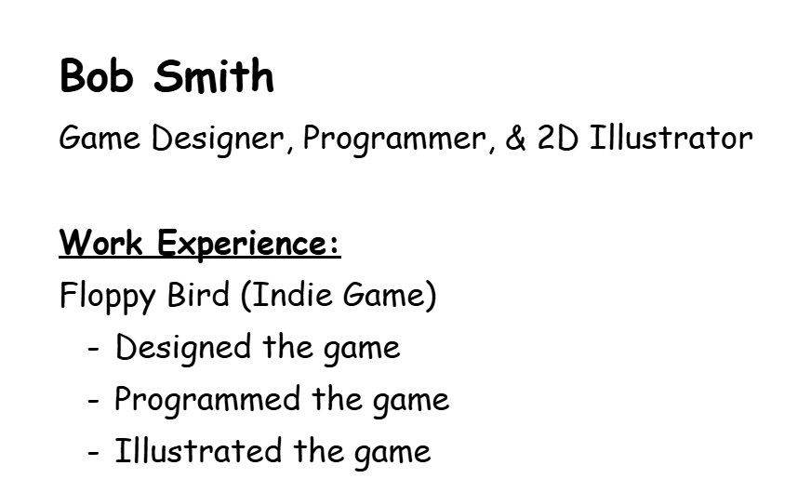
Choosing ONE Role
●
●
●
●
●
●
Notes:
5:00 - Maybe you’ve seen resume like this:
[Slide - Candidate is a Designer, Programmer, Artist, Game Director]
It says that this person is a designer, programmer, AND artist!
Now this candidate might be amazing at all of these things. And on a small team they have to be!
But THE larger the team, the more and more that developers specialize into a single role.
If he sends this resume to apply as an illustrator, all this other information can actually detract from the candidacy.
Photo Credit:
https://media.istockphoto.com/id/1128662901/photo/businessman-chooses-the-path-strategy.jpg?s=612x612&w=0&k=20&c=8Rzgwa45s9NdlRwVnMGT7_1DgdcSXvyUjE58J2m9XXE=
https://encrypted-tbn0.gstatic.com/images?q=tbn:ANd9GcT-iK1DYP6sjufqLpcXO14t7MHbzpd7kF_fLQ&s

Slide 19

Choosing ONE Role
●
●
●
●
●
●
Notes:
A resume is not a biography, it’s goal is to explain how just a subset of your experience applies to a role. -- a SPECIFIC role.
And a good resume is going to point at that role.
This resume points all over the place. To fix it, we need to aim it.
Photo Credit:
https://media.istockphoto.com/id/1128662901/photo/businessman-chooses-the-path-strategy.jpg?s=612x612&w=0&k=20&c=8Rzgwa45s9NdlRwVnMGT7_1DgdcSXvyUjE58J2m9XXE=
https://encrypted-tbn0.gstatic.com/images?q=tbn:ANd9GcT-iK1DYP6sjufqLpcXO14t7MHbzpd7kF_fLQ&s

Slide 20
Choosing ONE Role
●
●
●
●
●
●
Notes:
For example here I crossed-out the parts that were not relevant to being an illustrator.
Photo Credit:
https://encrypted-tbn0.gstatic.com/images?q=tbn:ANd9GcT-iK1DYP6sjufqLpcXO14t7MHbzpd7kF_fLQ&s

Slide 21
Choosing ONE Role
●
●
●
●
●
●
Enviornment Art focused Concept Artist &
- Developed mood board and multiple biome concepts
- Created modular character art for user customization
Notes:
The result is now I have more space to go deeper and provide more evidence on why I’m specifically a great ILLUSTRATOR.
Photo Credit:
https://encrypted-tbn0.gstatic.com/images?q=tbn:ANd9GcT-iK1DYP6sjufqLpcXO14t7MHbzpd7kF_fLQ&s

Slide 22

Choosing ONE Role
●
●
●
●
●
●
Enviornment Art focused Concept Artist &
- Developed mood board and multiple biome concepts
- Created modular character art for user customization
Notes:
The result is more focused, stronger, candidacy for the role.
We want to streamline the resume like this to show exactly what the hiring manager wants, as concisely as possible.
Photo Credit:
https://encrypted-tbn0.gstatic.com/images?q=tbn:ANd9GcT-iK1DYP6sjufqLpcXO14t7MHbzpd7kF_fLQ&s

Slide 23

But what if you do it all?
●
●
●
●
●
●
Notes:
But what if you do it all? -- What if you are the Swiss army knife of game devs?
Photo Credit:
https://media.victorinox.com/transform/33f2faec-362b-4f91-b657-a12f000daf96/SAK_1_7775_T__S1-tif?io=transform%3Abackground%2Ccolor%3AF0F0F0&io=transform%3Afit%2Cwidth%3A900%2Cheight%3A650&quality=80

Slide 24
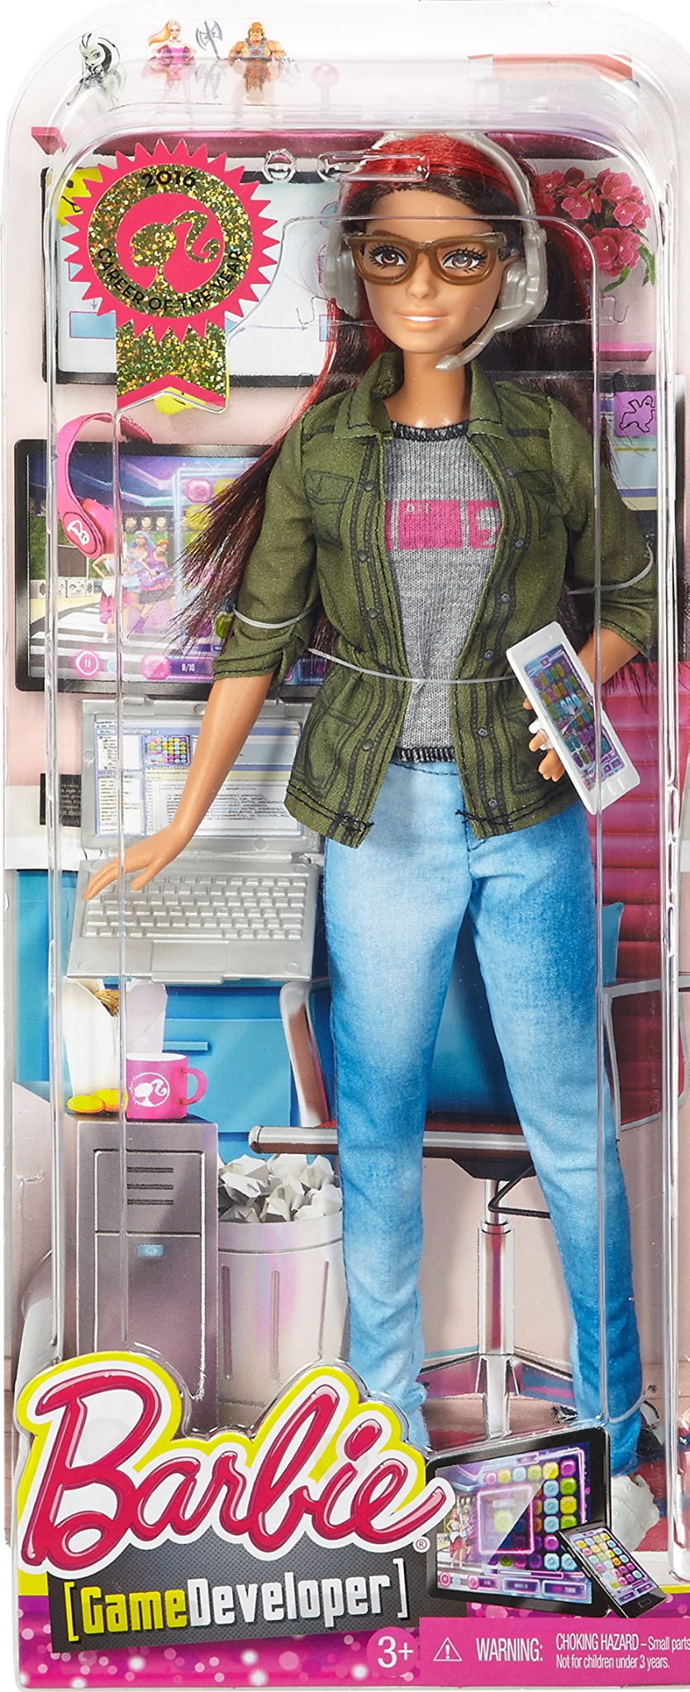
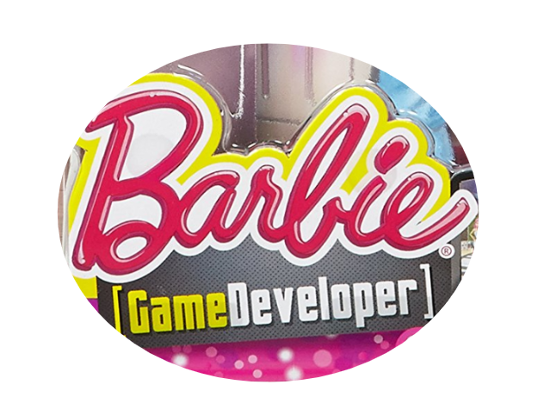
There’s no ‘Game Developer’ Role
●
●
●
●
●
●
Notes:
Well the truth is that at a game company, no one is hiring for a GENERIC “game developer”.
Photo Credit:
https://m.media-amazon.com/images/I/91N0+7+LXcL.jpg

Slide 25
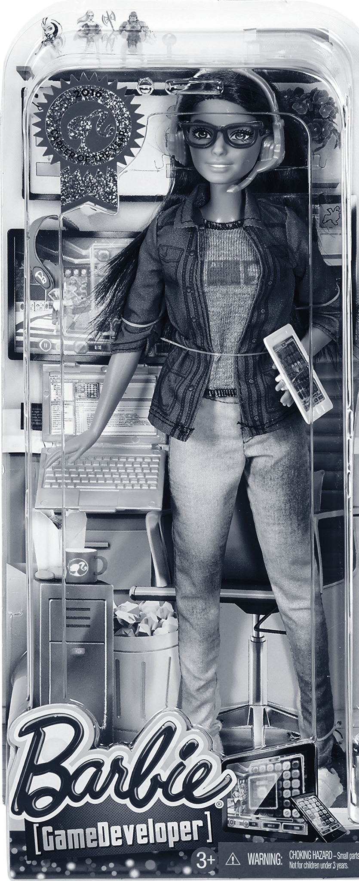
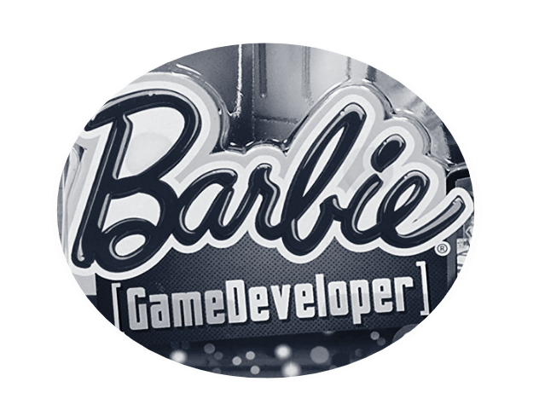

There’s no ‘Game Developer’ Role
●
●
●
●
●
●
Notes:
That is not a role… It doesn’t exist. But there are multidisciplinary roles. So if you have multiple skills we can find a role for that!
Photo Credit:
https://encrypted-tbn0.gstatic.com/images?q=tbn:ANd9GcT-iK1DYP6sjufqLpcXO14t7MHbzpd7kF_fLQ&s

Slide 26
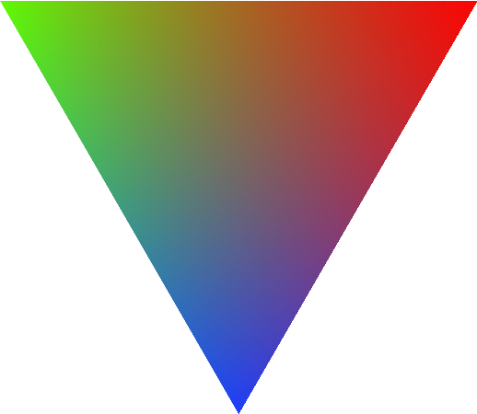
Map of Roles
●
●
●
●
●
●
Design
Engineering
Art
Notes:
Here’s how…
This is a MAP I made for my students. A game dev triangle.
We’ve got design, engineering, and art. You could also imagine production in the center there.
Within just these three departments: Design, Art, and Engineering, there are a TON of roles.
Photo Credit:
https://texample.net/media/tikz/examples/PNG/rgb-triangle.png

Slide 27
Map of Roles
●
●
●
●
●
●
Design
Engineering
Level Designer
Encounter Designer
Systems Designer
Technical Designer
Gameplay Engineer
Tools Engineer
Systems Engineer
Networking Engineer
Engine Programmer
Art
Notes:
We can take any axis and walk along it…
For example here are NINE roles that span from Design to Engineering. Each with a different balance of those two disciplines.
So if you KNOW you love design and engineering… we can research these roles and figure out which one is the right balance for you.
Photo Credit:
https://texample.net/media/tikz/examples/PNG/rgb-triangle.png

Slide 28
Map of Roles
●
●
●
●
●
●
Design
Engineering
You
Art
Notes:
Another way to think of it. Is to figure out, where on this map are YOU.
Photo Credit:
https://texample.net/media/tikz/examples/PNG/rgb-triangle.png

Slide 29
Map of Roles
●
●
●
●
●
●
Design
Engineering
Narrative Designer
Sound Designer
UI / UX Designer
You
UI Artist
Environment Artist
Character Artist
You
Art
Notes:
Because then you can look at the roles around that area… and RESEARCH them…. and figure out which ones might be a good fit.
If you want to apply to more than one role, that’s okay, just pick one to start, go through this whole process that we’ll outline today. And then you can repeat the process for the second role.
Photo Credit:
https://texample.net/media/tikz/examples/PNG/rgb-triangle.png

Slide 30
One Resume, Per Role
●
●
●
●
●
●
Designer Artist
Notes:
BUT remember: a particular resume or portfolio should always be focused on just one role.
If you want to pursue multiple roles, that means you need multiple resumes.
Photo Credit:
https://encrypted-tbn0.gstatic.com/images?q=tbn:ANd9GcT-iK1DYP6sjufqLpcXO14t7MHbzpd7kF_fLQ&s

Slide 31

Some roles are easier entry points
●
●
●
●
●
●
Notes:
At any particular company, some roles are going to be easier to land than others, even at the same seniority level.
This is why its so important to talk to people -- in the industry -- because they have that context WHICH can help you plan your path.
Photo Credit:
https://media.istockphoto.com/id/487829005/photo/big-and-small-door.jpg?s=612x612&w=0&k=20&c=cu4gYk0Qoy3wqQOK_DQVrnBgaA2j5VJ2nqSZ5ll_dME=

Slide 32
Some roles are easier entry points
●
●
●
●
●
●
Contracts &
Internships
Notes:
On this note, I’ll also say that CONTRACTs and INTERNSHIPs can allow you to gain experience while your on the path to a full-time role.
Though keep in mind, they may have special requirements for things like relocation or collgement enrollment
Photo Credit:
https://preview.redd.it/w5f7stxpmij41.jpg?width=786&format=pjpg&auto=webp&s=1510fb058d50eca5067d5b555a81d5fd5054225e

Slide 33

Is QA a Good Entry Point?
●
●
●
●
●
●
Notes:
What about Quality Assurance -- Game Testing -- People often ask, “is that good entry point”? The answer is.. not really unless QA itself is your goal.
Photo Credit:
https://blogger.googleusercontent.com/img/b/R29vZ2xl/AVvXsEgrrGPfrSzpzX2ZIiyUwvP6yQApcFfOWk-b8E98HP2jJO50Qdwn7RXJwSdpVOZuT6lROZpsVtqJkEsQARZqDqFGumqyBKyAO9fOxpJEeHkPj6WBYeuHgkc-Rt77Hsr2ZZFFNgCihPoyWy0D/s1600/fun_questions_to_ask_your_friends.jpg

Slide 34
Is QA a Good Entry Point?
●
●
●
●
●
●
Design
Engineering
Art
Notes:
QA is not in the triangle, and sometimes unfortunately they’re not even in the same building. So mobility is not great. QA these days is its own career track.
So if you do want to be on the triangle, make it your goal to get anywhere on the triangle and then you can move around.
Photo Credit:
https://blogger.googleusercontent.com/img/b/R29vZ2xl/AVvXsEgrrGPfrSzpzX2ZIiyUwvP6yQApcFfOWk-b8E98HP2jJO50Qdwn7RXJwSdpVOZuT6lROZpsVtqJkEsQARZqDqFGumqyBKyAO9fOxpJEeHkPj6WBYeuHgkc-Rt77Hsr2ZZFFNgCihPoyWy0D/s1600/fun_questions_to_ask_your_friends.jpg

Slide 35
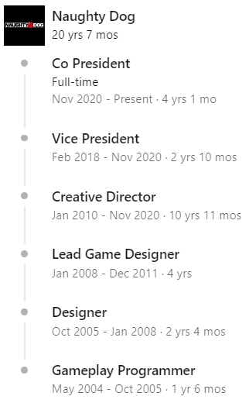
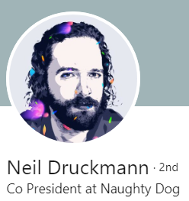
A Path to Your Dream Role
●
●
●
●
●
●
Notes:
Here’s an example, this is the career of Mr. Druckmann, President of Sony, Naughty Dog.
He loved storytelling, but when it came to his marketable skills he found an easier entry point as a tools programmer.
Then he became a gameplay programmer, one step closer.
Then becoming an designer, step-by-step towards his dream role - gaining the skills he needed along the way.
It’s a very common story - Todd Howard of Bethesda, same thing.
So whatever your dream role might be, I encourage you to research people in that role to learn what was their path, because it can help you plan your path.
Photo Credit:
https://www.linkedin.com/in/neil-druckmann-6739a0/

Slide 36
Roadmap
● Speaker Bio
● Roles
● Job Search
● Job Post Analysis
● Resumes
● Portfolios
Notes:
09:30 - Now, whatever role you choose. Let’s talk about how to find an opportunity for that role.
Photo Credit:
https://demri.net/about-us/142-foundational-documents/788-demri-roadmap

Slide 37



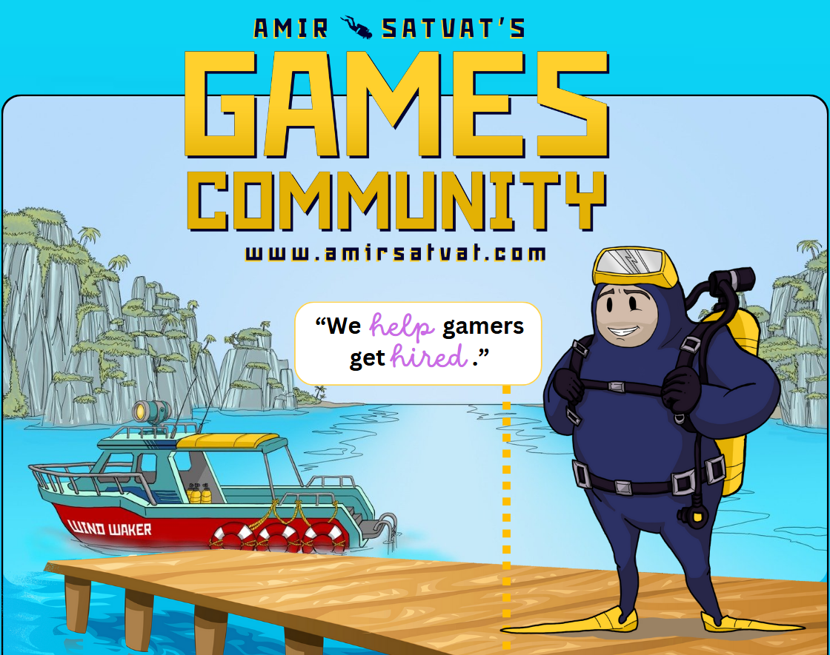

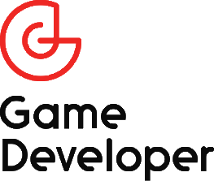
Finding Openings
●
●
●
●
●
●
Notes:
For openings there’s a website for each game studio, then there are third party websites where companies might post such as LinkedIN, and finally there are aggregator like Indeed or the gamedev specific AmirSatvat.com that list roles from across the industry.
Photo Credit:

Slide 38
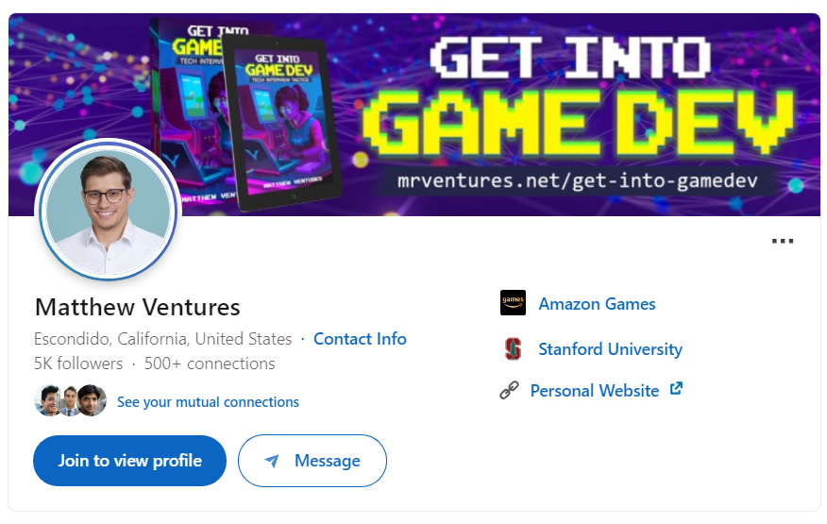


LinkedIn
●
●
●
●
●
●
Notes:
On LinkedIn, plain and simple, you should connect with as many people as possible.
Reach that cap of 25 requests a day.
Photo Credit:
https://t3.ftcdn.net/jpg/08/20/72/26/360_F_820722697_2RxSepsIFmy3O4Uo4YTUJkA6PDDC1V47.jpg

Slide 39
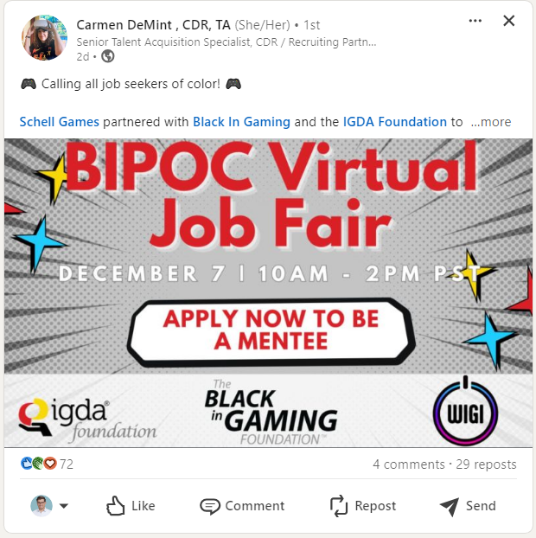
Opportunity
●
●
●
●
●
●
Notes:
More connections bring more opportunities. Here’s an example. I connected with Carmen and found out about this cool career fair. I would have never known about it if I didn’t make that connection.
Photo Credit:
https://www.linkedin.com/in/carmendemint/

Slide 40

Why Network?
●
●
●
●
●
●
Notes:
LinkedIn is ALSO a great way to talk to people.
Now talking to a random person probably won’t give you a job. But it might help you learn something which enriches you as a candidate and increases your chances of passing an interview… when the time comes.
Now I know it can be scary to talk to a stranger. He’s an opening that you might try:
Photo Credit:
https://images.ctfassets.net/pdf29us7flmy/1AsSiR4wypFFharphALP8M/64725592b03dbb9b1111e89730b08e68/teamwork_-_indeed_creative.jpg?w=720&q=100&fm=jpg

Slide 41
Example Opening
●
●
●
●
●
●
“Hello, I saw you did this THING for YOUR project, and I’m trying to do that same THING for MY project. How did you accomplish that THING? I thought it was really impressive!”
Notes:
“Hello, I saw you did this THING for YOUR project, and I’m trying to do that same THING for MY project. How did you accomplish that THING? I thought it was really impressive!”
IN THIS INDUSTRY, people care A LOT about their work. And it probably will mean a lot to someone if you notice that hard work. And remember to be specific because that shows you actually care.
Photo Credit:
https://images.ctfassets.net/pdf29us7flmy/1AsSiR4wypFFharphALP8M/64725592b03dbb9b1111e89730b08e68/teamwork_-_indeed_creative.jpg?w=720&q=100&fm=jpg

Slide 42
Bonus: Network Tips
●
●
●
●
●
●
Don’t say: “How can I prepare for…?”
Instead, say: “What advice would have helped you prepare for…?”
People love to talk about themselves. It helps people open up. This tends to come across less selfish, and you sound more curious.
Don’t say: “Will you be my mentor?”
Instead, say: “How would you approach this specific problem?”
If you do want to ask for help directly, try to be specific. Don’t ask someone to “mentor” you. Instead, bring them a specific problem that you need mentorship on.
Keep context in mind:
If you just send a message on LinkedIn then they probably will see you as just a random person on the internet. They might get that message while they’re busy or they just might not care to respond. And that’s okay.
Certainly, it is easier to build a connection with someone in person. A video chat is better than a phone call. And a phone call is better than text. But text is where you could start.
Text is more accessible:
I personally find it a little rude when someone asks me to “jump on a call” and wants to take my time, for free. That requires a lot of effort from me. But if they just send a quick text that’s direct and succinct I can just text them back. I’m way more likely to respond to a text, and maybe a relationship develops down the line.
Notes:
Now I do have quite a few more bonus tips, you can find them in the slides.

Slide 43
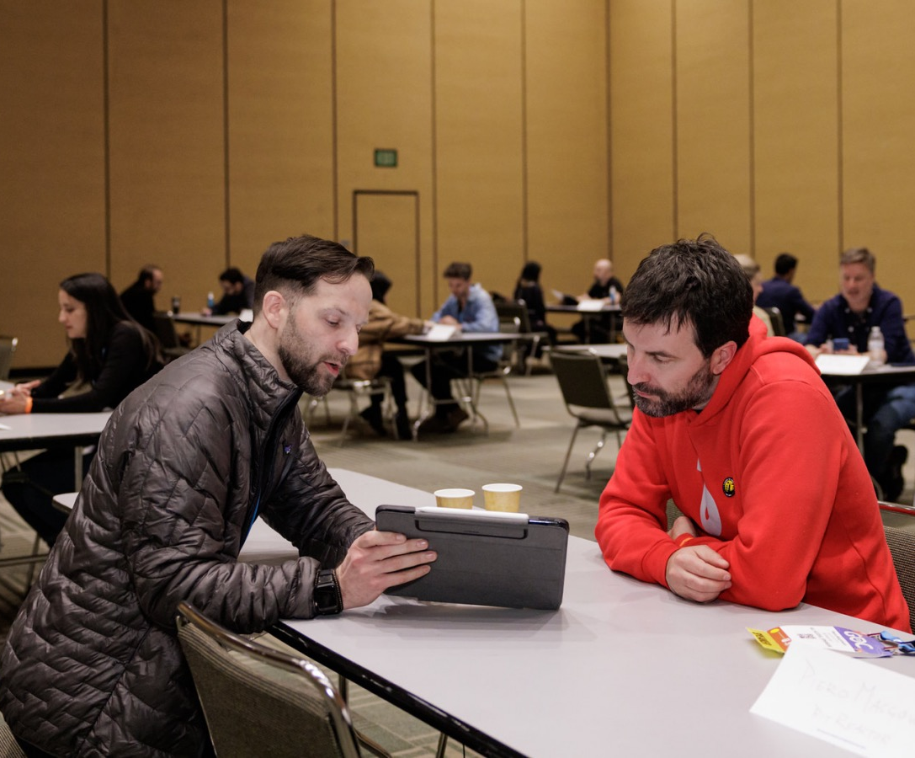
In-Person is Best!
●
●
●
●
●
●
GDC
Local IGDA
Game Jams
Career Fairs
Meetup.com
Notes:
And even though LinkedIn is great, you’ll probably have more luck building connections, IN-PERSON, at events like GDC, IGDA, game jams, etc. It’s really important to put yourself out there.
Photo Credit:
https://gdconf.com/sites/default/files/speed%20networking.jpg

Slide 44
Roadmap
● Speaker Bio
● Roles
● Job Search
● Job Post Analysis
● Resumes
● Portfolios
Notes:
10:30 / 12:30 - Okay so let’s say you found a job post for your target role.
Photo Credit:
https://demri.net/about-us/142-foundational-documents/788-demri-roadmap

Slide 45

Reading a Job Post
●
●
●
●
●
●
Notes:
When we look at a job post, our goal is to extract keywords.
After you’ve seen a ton of job posts, you’ll start to see patterns.
You’ll start to recognize the boiler plate versus the parts that actually came from the hiring manager.
Some keywords are going to be very common, for example coders are going to see lots of the same programming languages.
But some keywords are going to be rare, and it’s those which can really set you apart.
Because if you take a weekend to learn an obscure technology you might be the only one who actually checks off that box.

Slide 46
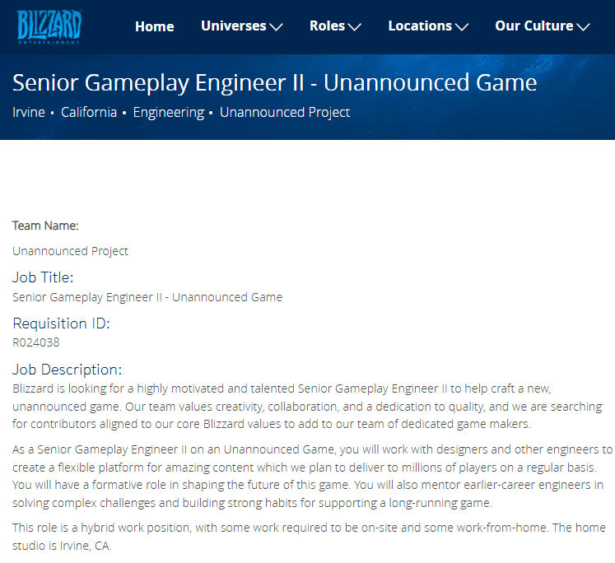
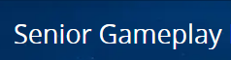
Reading a Job Post
●
●
●
●
●
●
Notes:
Here’s how to read a job post.
And the first keyword is the seniority. In this case, it’s a Senior position.
TYPICALLY meaning 5, or more, years of prior experience.
College doesn’t count. Internships do not count….
AND -by the way- If the role doesn't specify a seniority then it is implicitly mid-level.
TYPICALLY meaning 2, or more, years of experience
Photo Credit:
https://careers.blizzard.com/global/en/job/R024038/Senior-Gameplay-Engineer-II-Unannounced-Game

Slide 47

Roles for New Grads
●
●
●
●
●
●
“Junior”
“Associate”
Roles
Notes:
Now if you’re a new grad, that minimum experience might be a little scary.
However there ARE roles for you. You want to see “associate” or “junior” in the title.
Apply to others sure, but know that these roles are made for you.
Photo Credit:
https://stradaeducation.org/wp-content/uploads/2018/01/crisis-scaled-1.jpeg

Slide 48
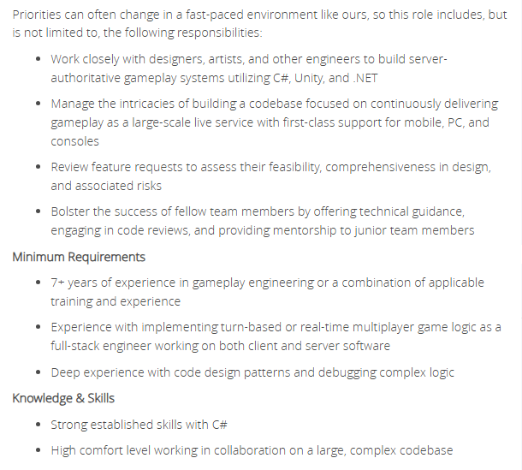
Reading a Job Post
●
●
●
●
●
●
Notes:
So I skimmed the rest of this job post, I collected some more keywords, and in total here’s what we got:
Photo Credit:
https://careers.blizzard.com/global/en/job/R024038/Senior-Gameplay-Engineer-II-Unannounced-Game

Slide 49
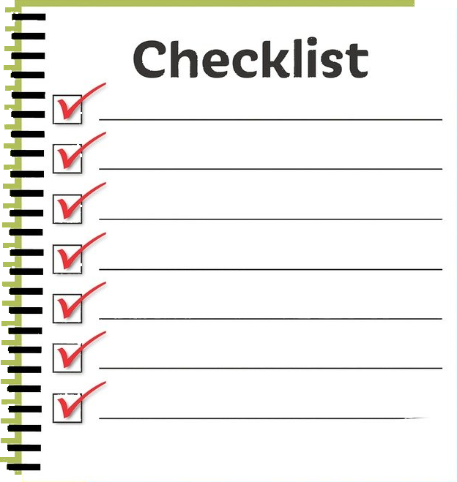

Make a Checklist of Keywords
●
●
●
●
●
●
Senior
Unity
Mobile
Multiplayer
Notes:
Senior, Unity, Mobile, Multiplayer.
The hiring manager is like a customer and this is their order. And you are the chef and you better cook what they asked for.
If we are missing an ingredient, let’s say for example let’s say you don’t have experience with a multiplayer game, then we’ll discuss how a portfolio piece can fill in that gap.
But ultimately our goal is to take these keywords and form a recipe for exactly the candidate they want. And that recipe IS our resume.
Photo Credit:
https://www.cpapracticeadvisor.com/wp-content/uploads/sites/2/2021/09/checklist_pixabay_mohamed_hassan_3679741_1280.6136f45b817cf.png

Slide 50
Roadmap
● Speaker Bio
● Roles
● Job Search
● Job Post Analysis
● Resumes
● Portfolios
Notes:
Let’s talk about resumes.
Photo Credit:
https://demri.net/about-us/142-foundational-documents/788-demri-roadmap

Slide 51
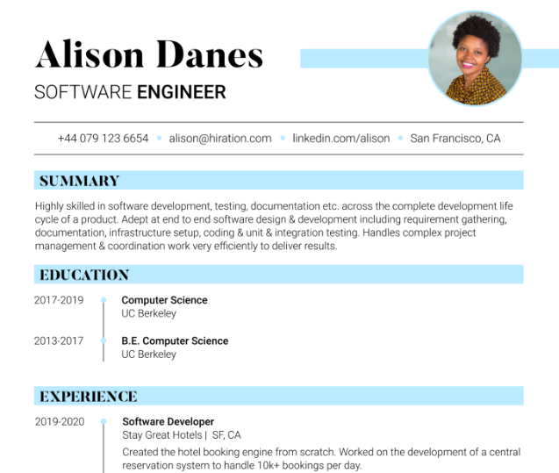
Curate your resume
●
●
●
●
●
●
Don’t Include:
Face
Age
Address
Graduation date
Notes:
A resume should ONLY include things you want to be EVALUATED on.
For example, your college graduation date, is implicitly your age. -- Only include it if you want to be judged on that.
Every piece of your resume tells it’s own story…
Photo Credit:
https://s3-us-west-2.amazonaws.com/hiration/ghost/2023/03/headshot-resume-images-example.png

Slide 52
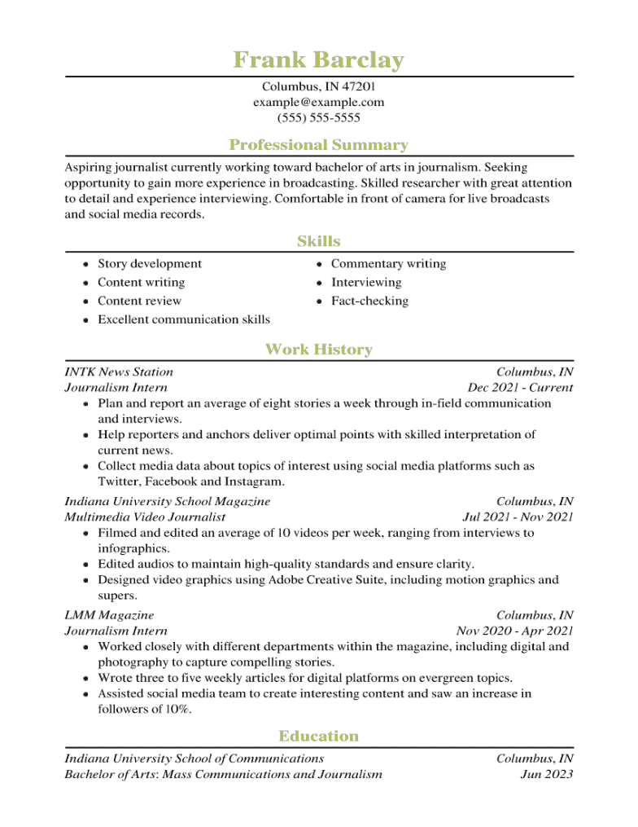
Resume directionality
●
●
●
●
●
●
Notes:
Or another way to say that is: every piece of information points in its own direction.
With every single data point I want you to be critical and ask yourself, is this pointing towards the role.
Photo Credit:
https://www.resumehelp.com/wp-content/uploads/2022/11/Student-Resume-Example-RH-1-min.png

Slide 53
Design
Engineering
●
●
●
●
●
●
Art
Notes:
Remember the triangle map. A lot of these roles are on a spectrum.
Photo Credit:
https://www.resumehelp.com/wp-content/uploads/2022/11/Student-Resume-Example-RH-1-min.png

Slide 54

Design
Engineering
●
●
●
●
●
●
Art
Notes:
You might apply for a design role that’s over here. Or you might apply for a design role, that’s instead…
Photo Credit:
https://www.resumehelp.com/wp-content/uploads/2022/11/Student-Resume-Example-RH-1-min.png
https://www.just-bu.org/uploads/blogs/header_image_1666272314.jpg

Slide 55
Design
Engineering
●
●
●
●
●
●
Art
Notes:
… all the way up here. Now you don’t need a completely new resume to apply to this role.
But you may want to go through your resume and tune it, edit the details to aim it towards that new target.
Photo Credit:
https://www.resumehelp.com/wp-content/uploads/2022/11/Student-Resume-Example-RH-1-min.png
https://www.just-bu.org/uploads/blogs/header_image_1666272314.jpg

Slide 56
Design
Engineering
●
●
●
●
●
●
Art
Notes:
Ideally we can point all those individuals pieces towards the role.
When they read the resume, we want them to think, “wow this person seems destined for this role”
But that’s only because we took the time to write your story with this ending PLANNED.
Photo Credit:
https://www.resumehelp.com/wp-content/uploads/2022/11/Student-Resume-Example-RH-1-min.png
https://www.just-bu.org/uploads/blogs/header_image_1666272314.jpg

Slide 57
We know what they want!
●
●
●
●
●
●
Senior
Unity
Mobile
Multiplayer
Notes:
We know what they want, because they literally told us in the job post. Unity, Mobile, Multiplayer. Go through that list, like a checklist.
So if you HAVE a Unity project you want to put that at the top. Maybe you made a unity game, but didn’t indicate that it was a mobile game. In that case you want to go in there and edit the line item so that it specifically says “Unity mobile”.
We don’t want a missing keyword to ruin your candidacy. But we are not going to lie on our resume. Later we’ll cover how a portfolio piece can provide that missing keyword.
The key takeaway is to make sure we deliver what they asked for. Including the so-called “nice to haves”.
Photo Credit:
https://www.cpapracticeadvisor.com/wp-content/uploads/sites/2/2021/09/checklist_pixabay_mohamed_hassan_3679741_1280.6136f45b817cf.png

Slide 58
Resumes list achievements,
not responsibilities
●
●
●
●
●
●
Notes:
17:45 - In terms of content… A great resume is a list of achievements, not responsibilities.
Let me show you what I mean…
Photo Credit:
x

Slide 59
Responsibility vs Achievement
●
●
●
●
●
●
Good: Developed a runtime tool to test weapon attachment configurations.
Notes:
Here’s an example of a resume entry that’s not great. “Developed a runtime tool to test weapon attachment configurations”
It’s not terrible, but it could be a lot better.
Photo Credit:
x

Slide 60
Responsibility vs Achievement
●
●
●
●
●
●
Good: Developed a runtime tool to test weapon attachment configurations.
Great: Programmed a C++ IMGui tool to quickly test over 300 weapon attachment configurations, improving QA testing speed from several minutes to a few seconds.
Notes:
Here’s an much better example: Programmed a C++ IMGui tool to quickly test over 300 weapon attachment configurations, improving QA testing speed from several minutes to a few seconds.
Why is this a better resume entry? After all, these two entries could be describing the same exact work.
The main reason, is because the bottom entry is an achievement.
Photo Credit:
x

Slide 61
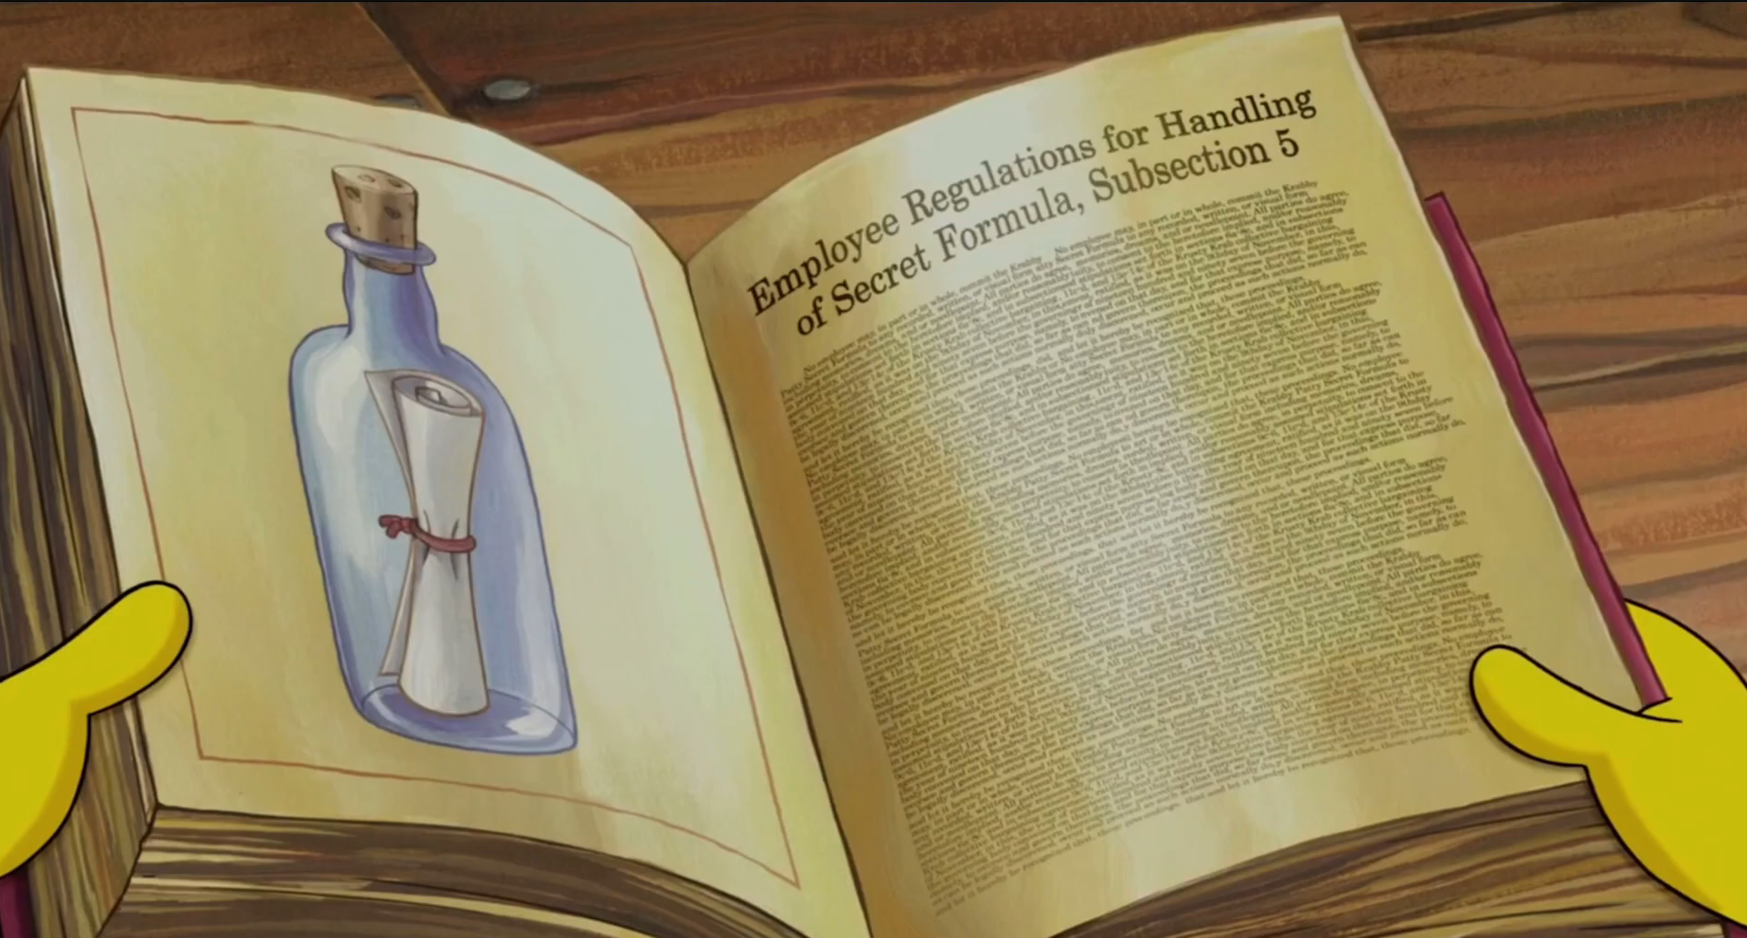
Resume entry formula (secret!)
●
●
●
●
●
●
Notes:
Now to write those entries as achievements, I’m about to share with you the SECRET FORMULA.
Photo Credit:
https://www.youtube.com/watch?v=wqrpJN_S1wE&ab_channel=SpongeBobSquarePantsNickJr

Slide 62

action + skill = result
Notes:
Action plus skill equals result.
Let’s see this formula applied to the previous example.
Photo Credit:
https://www.youtube.com/watch?v=wqrpJN_S1wE&ab_channel=SpongeBobSquarePantsNickJr

Slide 63
Resume entry formula
●
●
●
●
●
●
action + skill = result
Good: Programmed a C++ IMGui tool to quickly test over 300 weapon attachment configurations, improving QA testing speed from several minutes to a few seconds.
Notes:
Action plus skill equals result.
The action is “Programmed”.
Here we want a varied set of strong “action verbs”. I recommend looking up “MIT action verbs”, those are some great examples.
The skill is “C++”.
Notice that we EMBED the skill into the entry. You NEVER want to just “tell” your skills. You INSTEAD want to “show” the skills through listing relevant work experience.
The result is “going from minutes to seconds”.
We are always looking for quantitative data, in this case we are measuring time. I always say, try to find a number. If we can find a NUMBER it will lead us to an ACHIEVEMENT.

Slide 64
Find the Numbers
●
●
●
●
●
●
I fix bugs
vs
I fixed 5 bugs
Notes:
For example, if your job was to “fix bugs” your achievement might be that you “fixed 5 bugs”. Just adding a number like that can turn it from a responsibility into an achievement.

Slide 65
Resume entry formula
●
●
●
●
●
●
action + skill = result
Notes:
So that’s the formula. We may not NEED this, but we WANT this. We’re starting to talk about the difference between a GOOD candidate and a GREAT candidate.
A GREAT resume is a list of achievements, not responsibilities.

Slide 66
Bonus resume tips
●
●
●
●
●
●
When you use verbs, make them all the same tense.
Try to avoid vague words like leveraged. Instead of “developed” say how you developed it such as “programmed” or “designed”: this is a place where being specific HELPS you.
There are other places where being specific can HURT you, like your graduation date or your address. When you’re vague, people tend to fill in the blanks with what they want to hear. So in some cases it can help to be vague.
Never quantify your skill competency, for example never say, “I have 75% C++ skill”. You should not be making a list of skills anyway. And a resume should never have a bar graph, bulleted list, or ranking of skills.
If you have a project where you did multiple roles, just list the role you are applying for. If I made an indie game, and I made the whole game but I’m applying as a programmer, I’m just going to say that I programmed it.
Keep your resume easy to skim-read. Use bullet points, not paragraphs.
Don’t list your college courses, state what you achieved in them (like making a final project).
Notes:
20:15 - Okay I don’t have time to go through them all but there are a ton of extra tips in the slides link.

Slide 67
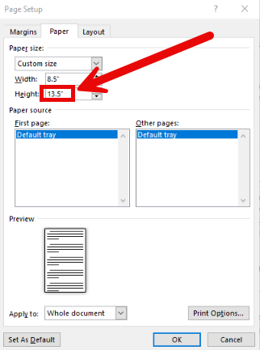

Bonus resume tips
●
●
●
●
●
●
One final tip for your resume. Okay, I’m going to teach you a little secret. Now you ALREADY know a resume should only be one page. But let's say you have a lot of projects and you can’t quiiiite fit it into one page. Don’t be afraid to just make the page bigger. Instead of 8.5 by 11 inches. Make it 12 or 13 inches. They’re not going to print it! Nobody’s going to know. How would they know? They’re not going to know. Okay, just don’t tell anybody. Shhhh, secret.
  This idea was inspired from Stone Librande, from his lecture in my Stanford course: https://www.youtube.com/watch?v=GXmsxYm0Mk0
Notes:
[Skip]
Photo Credit:
https://thumbs.dreamstime.com/b/top-secret-vector-stamp-ink-42538693.jpg

Slide 68
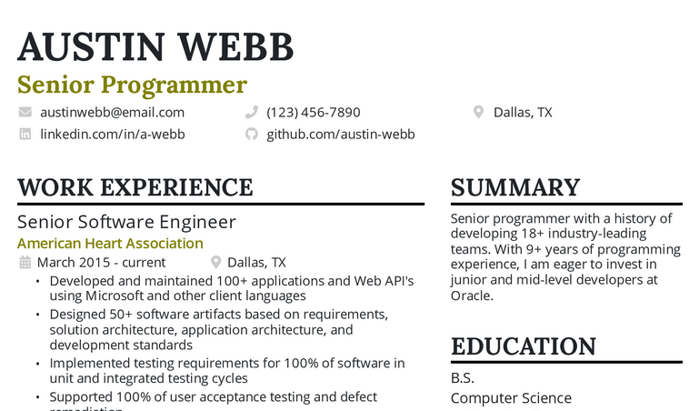
Bonus resume tips
●
●
●
●
●
●
Notes:
One I just want to highlight is make sure to put the title you want in BIG letters right next to your name.
It’s good positive psychology, it gets them to associate you with the role, and it explicitly defines the resume’s direction.
Photo Credit:
https://d25zcttzf44i59.cloudfront.net/senior-programmer-resume-example.png

Slide 69
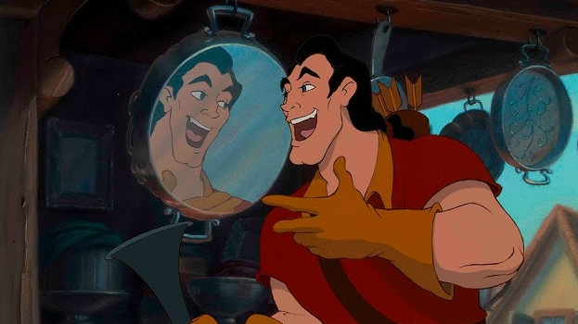
●
●
●
●
●
●
Notes:
But my NUMBER ONE resume tip. Is you can’t just look at your own resume.
Alot of candidates have only ever read one resume - their own.
That’s not good. You wouldn’t make a game without playing games right? You’ve got to read other resumes!
Because just by reading a bunch of resumes, you’re going to naturally see what makes some of them stand out..
Photo Credit:
https://d25zcttzf44i59.cloudfront.net/senior-programmer-resume-example.png

Slide 70
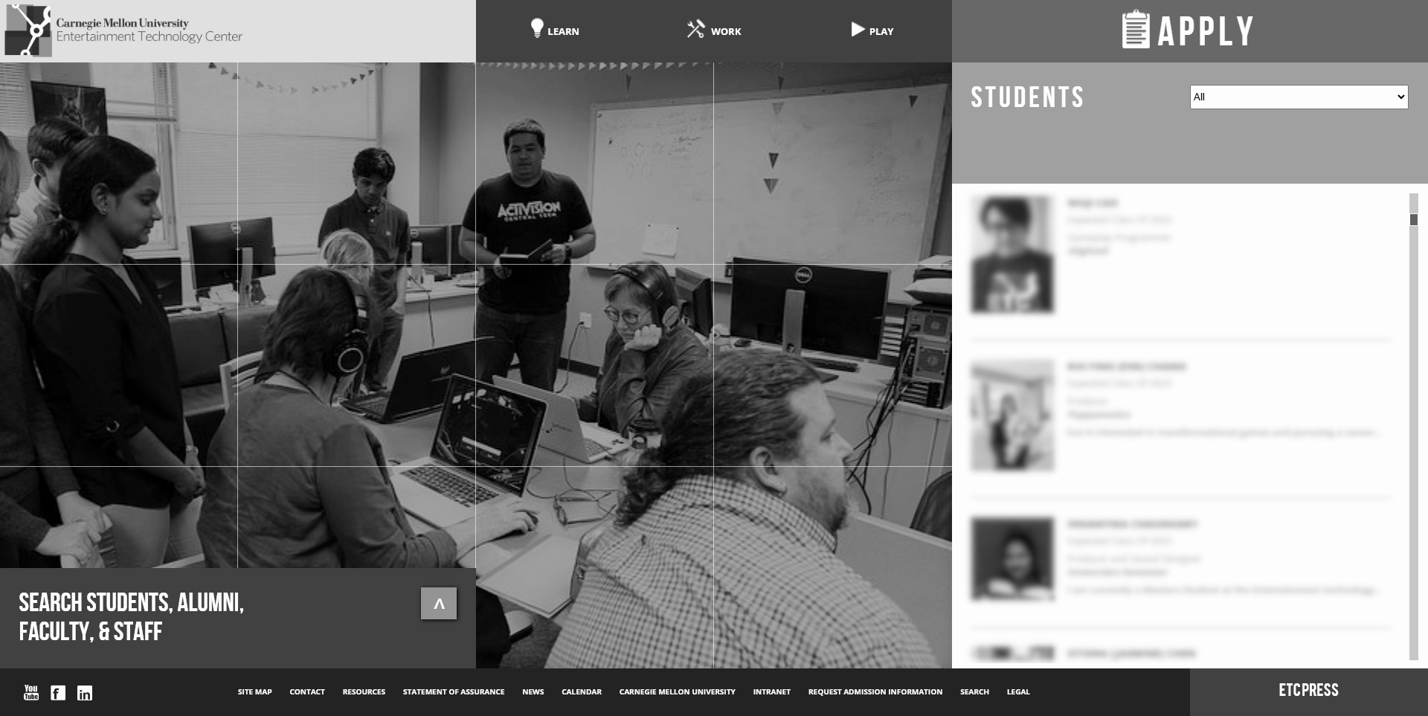
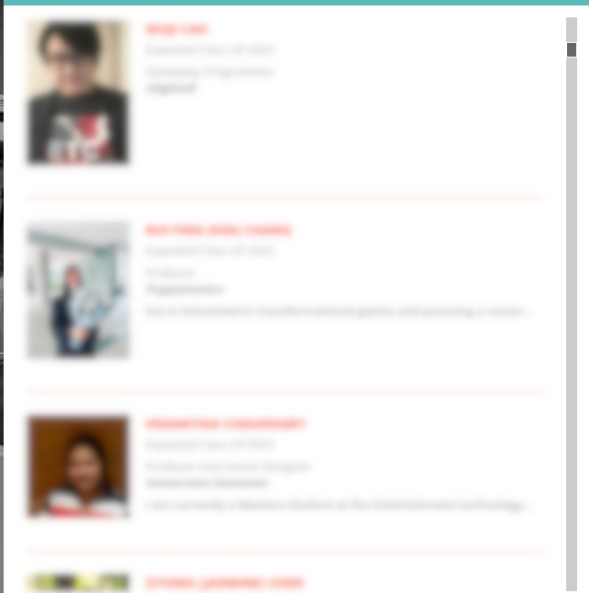
Read other resumes!
●
●
●
●
●
●
https://www.etc.cmu.edu/learn/students
Notes:
For students, I recommend you checkout the university website of CMU ETC,
every year they post ALL the resumes of their graduating class.
So you can SEE them and STUDY them.
You can pretend to be a hiring manager and compare their resumes to your own, or do this with friends.
It’s a great way to find your areas of improvement.
You’ve got to the know your competition……(Breathe!)
Photo Credit:
x

Slide 71


Missing keywords?
●
●
●
●
●
●
Senior
Unity
Mobile
Multiplayer
Notes:
So let’s say your resume IS competitive.
And NOW, you go through it with your keyword checklist: Unity, Mobile, Multiplayer.
Let’s say you’ve got Unity AND mobile, but you haven’t done any multiplayer projects … should you still apply?
….You could. But if you have the time, this is exactly where a focused portfolio piece can fill in the gap.
Portfolio projects are a way for us to manufacture experience in areas where our resumes would otherwise fall short.
Photo Credit:
https://worldclasstutoring.com/wp-content/uploads/2024/06/man-5723449_1280.jpg

Slide 72
Roadmap
● Speaker Bio
● Roles
● Job Search
● Job Post Analysis
● Resumes
● Portfolios
Notes:
22:00 - Okay, there are MANY kinds of portfolio pieces. But for most folks you’re going to want to build something called a demo.
Photo Credit:
https://demri.net/about-us/142-foundational-documents/788-demri-roadmap

Slide 73

Portfolio type: demo
●
●
●
●
●
●
Senior
Unity
Mobile
Multiplaer
Notes:
Demos are extremely LEAN, the whole point is to get it done fast. Pick a competency, like Multiplayer, and build a super-small demo to demonstrate that competency.
Photo Credit:
x

Slide 74
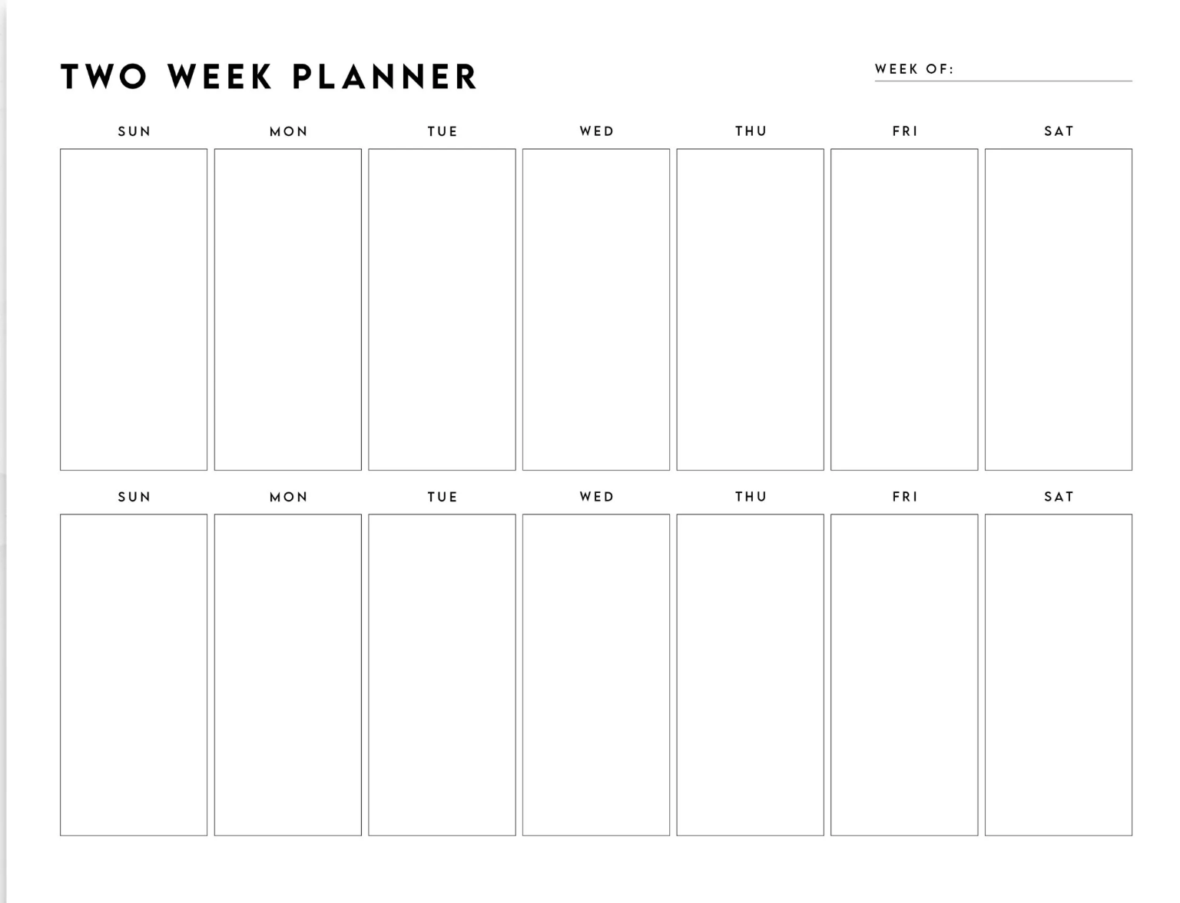
Two weeks max
●
●
●
●
●
●
Notes:
Two weeks is probably the maximum time commitment we are talking about here. Two Weeks. We are not trying to build a game. They don’t need to play it.
Photo Credit:
https://www.etsy.com/listing/1420671629/two-week-planner-printable-weekly

Slide 75
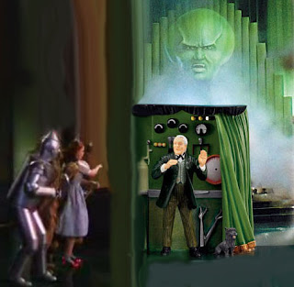
Competency, not creativity
●
●
●
●
●
●
Notes:
It’s okay for there to be a man behind the curtain. You’re NOT going to sell a tech demo.
And it’s fine if your demo is a copy of another game.
In fact, you might get bonus points if your demo emulates a game from the studio you are applying to. That’s flattery.
But the key point is we are NOT trying to be creative here.
We’re just trying to demonstrate competency.
Photo Credit:
https://7criminalminds.blogspot.com/2018/07/the-man-behind-curtain.html

Slide 76
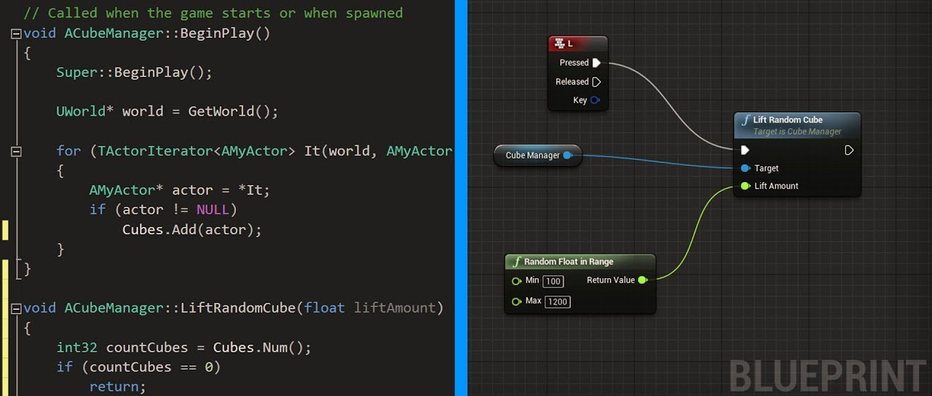
Coders code, scripters script
●
●
●
●
●
●
Notes:
23:30 - Make sure you are demonstrating the right competencies. For example: if you’re a coder, then make sure you’re coding. Do not show them a demo that ONLY has scripting, like blueprints. You don’t want them to think you used blueprints because you didn’t know how to code.
Photo Credit:
https://m.youtube.com/watch?v=9sPWVJKYJ_0

Slide 77
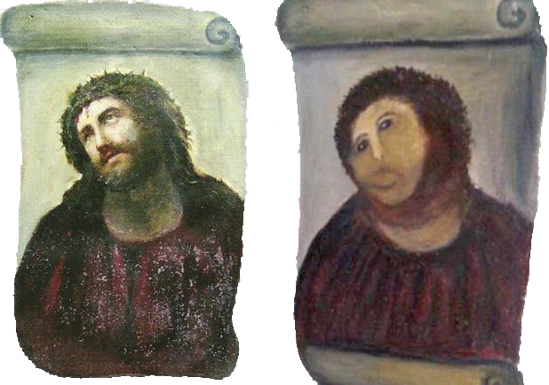
Don’t art unless you’re an artist
●
●
●
●
●
●
vs
Notes:
Likewise, unless the role asks for YOUR art, it has no place in the portfolio. Instead download or purchase the BEST art you can.
It’s really hard to see past bad art. But great art can provide a halo effect (halo-sound) to make your code and designs look better.
Likewise, if you’re an artist just download the gameplay demos, you don’t need to teach yourself how to code.
Photo Credit:
https://news.artnet.com/app/news-upload/2014/04/Ecce-Homo.jpg

Slide 78
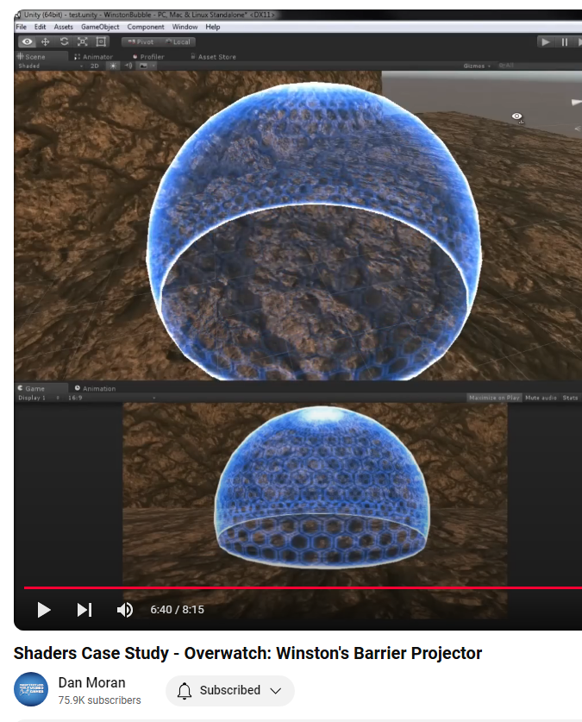
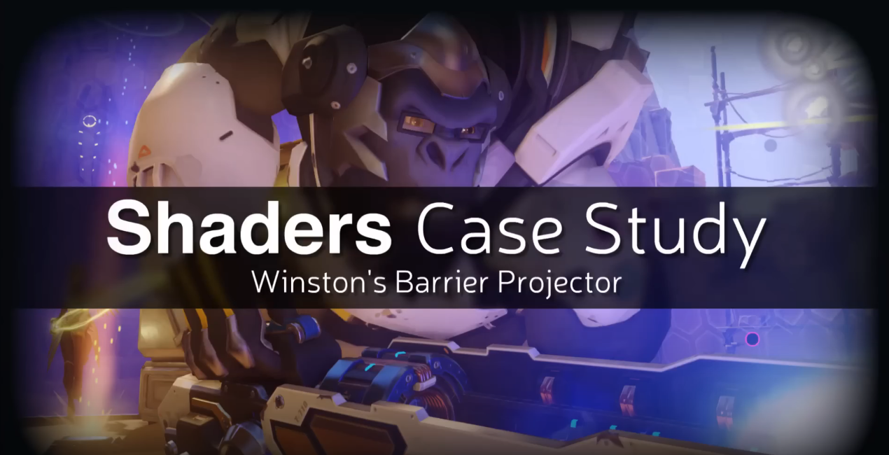
Example demo
●
●
●
●
●
●
Senior
Unity
Mobile
Multiplaer
https://tinyurl.com/dan-moran
Notes:
Here’s an example of a great demo. This is from my friend Dan, he has a YouTube channel and he recreates visuals effects from popular games.
In this case he recreated the Winston barrier effect from Overwatch.
I want to emphasize that this shader demo does not have any gameplay. That’s because he is focused. He’s not trying to show gameplay, he’s just trying to show cool graphics. He’s focused on a single core competency.
So that’s a demo, demos are great.
Photo Credit:
https://youtu.be/C6lGEgcHbWc?si=QkMBjJrBiFiAesQt

Slide 79
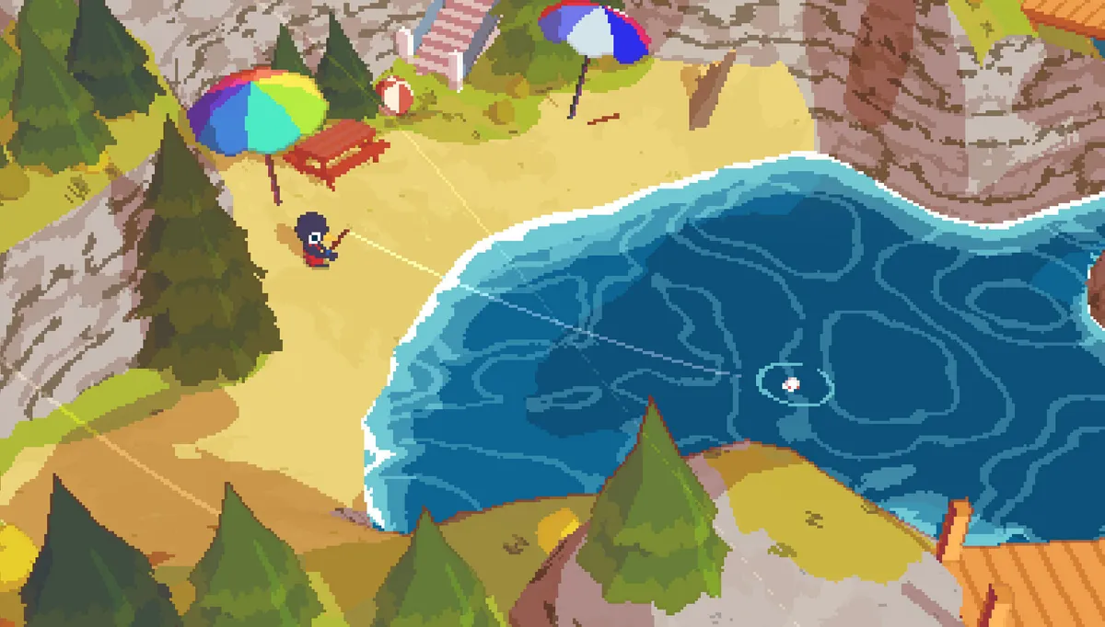
Portfolio type: indie game / mod
●
●
●
●
●
●
Notes:
Another type of portfolio piece is an indie project.
Now I LOVE indie games, but they are not an EFFICIENT time investment for portfolios.
A portfolio piece ideally should be focused on just one thing, but games are usually a bunch of things, so it results in some of your time being wasted when it could have been more focused.
But maybe you already made a game. So if we’ve got it, let me tell you how to show it.
Photo Credit:
https://www.cnet.com/a/img/resize/8291c9bc89930ad740842d53ed5d03ae6aaca2c2/hub/2020/03/13/7345e682-1f6e-4893-895d-079ec4d979bc/shorthike.jpg?auto=webp&width=1200

Slide 80

Tip #1 - make it accessible
●
●
●
●
●
●
Notes:
Make the portfolio piece accessible. Keep in mind that the portfolio piece is not the game itself. The portfolio piece is a writeup or video-explainer of a feature WITHIN your game.
When I say video-explainer I DO NOT mean “game trailer”. A trailer is a marketing asset for potential CUSTOMERS. Your portfolio reviewer is a different audience, they really do deserve their own video.
Don’t expect them to download or play the game, instead you want to make something like a video that just jumps directly into showing them what you achieved.
Photo Credit:
https://t3.ftcdn.net/jpg/05/35/24/04/360_F_535240482_E2FCPJa9Pw914WrvkV6ipzPjpJVSCBSW.jpg

Slide 81

Tip #2 - finish!
●
●
●
●
●
●
Notes:
My second tip is not a tip, it’s a requirement. You HAVE to finish.
This type of project is effective when you release it, because then you get social proof of your competency.
We don’t want you getting stuck on creativity problems, when you should be focused on demsontrating competency.
Photo Credit:
https://media.istockphoto.com/id/1247728111/photo/man-wears-business-suit-and-pushes-big-rock-up-a-hill.jpg?s=612x612&w=0&k=20&c=oVFXZoU27HVrbDAn3PzLlNxRd928dEnAYY-cW6-nrtw=

Slide 82
Bonus indie project tips
●
●
●
●
●
●
Make it free: reaching thousands of players is usually worth more than selling hundreds of copies.
Make it accessible: Never ask a reviewer to download your game. Instead embed a video DIRECTLY in your web page to show them EXACTLY what they need to see.
Make it using the tools that the developers at your dream studio use. For example, if you’re applying to work at Epic Games, it would be ideal to have projects that used their own Unreal Engine toolset.
Last, know that reviewers often skip student projects. They might think: “this was a responsibility for a class, rather than an achievement”. So if your piece started as a student project, put in the extra time to say that, while it may have started as a student project, we’ve now released it to real players.
Indie projects need not be games, you can instead make a mod, or a tool on the Unity Asset store or Unreal Marketplace, or even just make a thoughtful YouTube video essay or blog post.
Notes:
And I put a few BONUS tips in the slides.
Photo Credit:
x

Slide 83
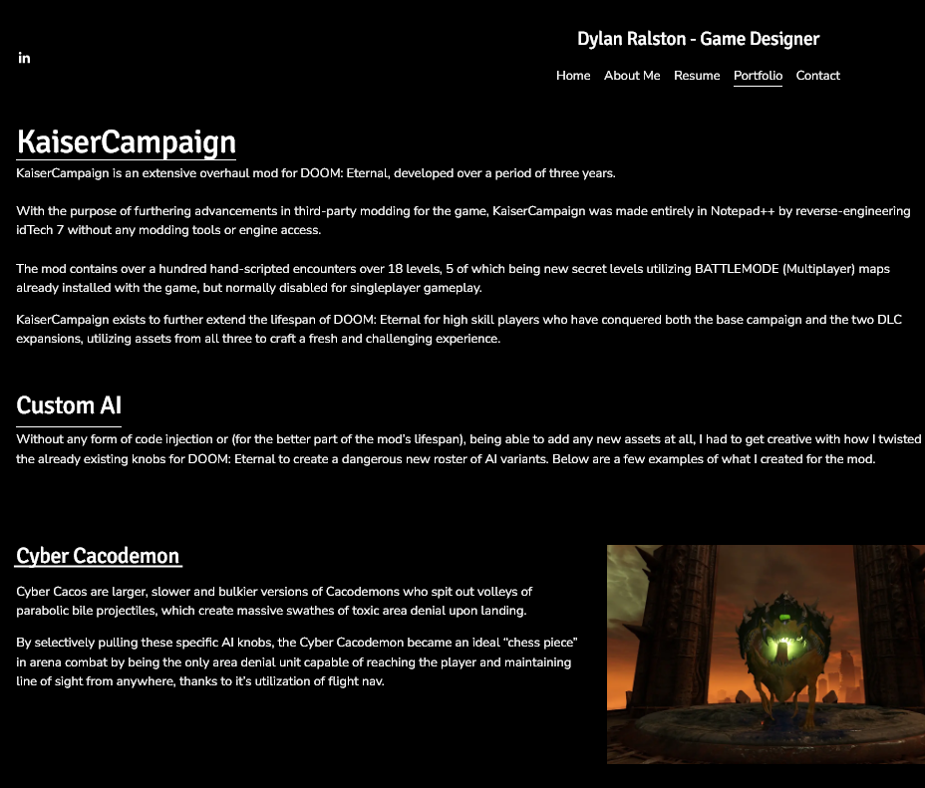
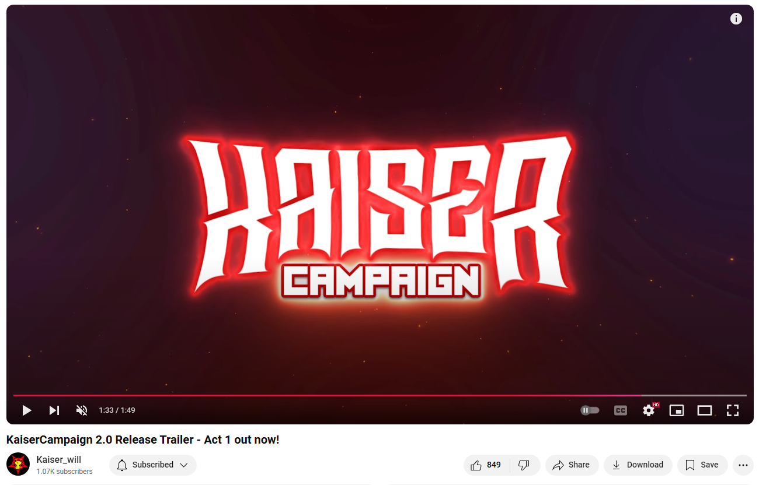
Example mod
●
●
●
●
●
●
Senior
Unity
Mobile
Multiplaer
https://tinyurl.com/kaiser-two
Notes:
Here’s an example of a great indie project. This is from my friend who goes by the name kaiser_will.
He made a mod for the game Doom Eternal. He’s got a great writeup on his website that covers the implementation details. The mod is extremely popular which tells the game studios that he can make something that they can sell.
So that’s a indie project, not for everyone, but it can quite effective. Again, I only recommend this is you’ve already made it.
Photo Credit:
https://dylan-ralston-portfolio.squarespace.com/portfolio/#kaisercampaign

Slide 84
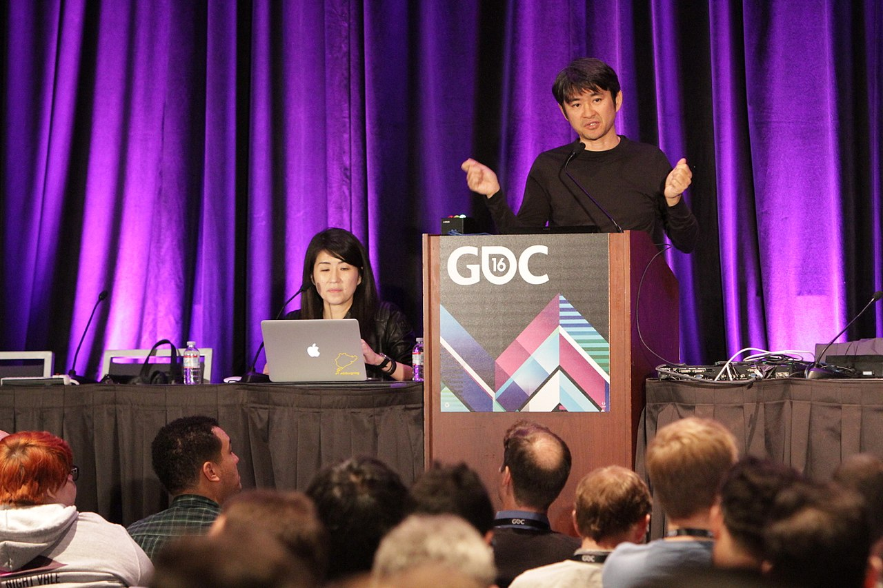
Portfolio type: recap
●
●
●
●
●
●
Senior
Unity
Mobile
Multiplaer
Notes:
Okay our final portfolio type is a recap or “post-mortem” of work on a larger project. Most GDC talks are basically this kind of portfolio piece.
Photo Credit:
https://upload.wikimedia.org/wikipedia/commons/thumb/c/ca/Classic_Game_Postmortem_-_Rez_-_GDC_2016_%2825244536163%29.jpg/1280px-Classic_Game_Postmortem_-_Rez_-_GDC_2016_%2825244536163%29.jpg

Slide 85


Example recap
●
●
●
●
●
●
“Human Body Looting”
https://tinyurl.com/jeff-rd2
Notes:
We’re going to jump right into an example. This is from my friend Jeff he worked on Red Dead Redemption 2.
And what we have here is basically just a blog page with some explainer text and embedded YouTube videos.
And again, note that THE GAME Red Redemption itself is NOT his portfolio piece. His portfolio pieces are specific features WITHIN the game.
Even if you made the whole game, you still want to focus on just one or two features that show off the relevant competencies from the checklist.
Photo Credit:
https://afloatingpoint.blogspot.com/2018/11/red-dead-redemption-2-recap.html

Slide 86

Example recap
●
●
●
●
●
●
Notes:
This is not a fancy website, it’s Blogspot.com, and that’s fine. He didn’t need to make his own website, because he’s not trying to be a web developer.
For programmers, I recommend Weebly. For artists, use Artstation. What’s important is to just make it as easy as possible to evaluate the work.
Okay so that’s a “recap”, sometimes called a post-mortem.
Photo Credit:
https://afloatingpoint.blogspot.com/2018/11/red-dead-redemption-2-recap.html

Slide 87
Roadmap
● Speaker Bio
● Roles
● Job Search
● Job Post Analysis
● Resumes
● Portfolios
● Bonus Topics!
Notes:
Okay now they were’nt on the official roadmap but I do have a few QUICK bonus topics for you!
Photo Credit:
https://demri.net/about-us/142-foundational-documents/788-demri-roadmap

Slide 88
Cover Letters
●
●
●
●
●
●
… I ain’t covering ‘em!
●
Notes:
I had planned to go over cover letters, but really… unless you have a major career transition or gap in your work history, you probably don’t need one.
If they ASK for a cover letter, I’ve included a template that you can use in the bonus slides... But otherwise I would not worry about it.
Photo Credit:
https://afloatingpoint.blogspot.com/2018/11/red-dead-redemption-2-recap.html

Slide 89
Bonus: cover letter template
●
●
●
●
●
●
Example cover letter:
Hello,
I’m an experienced gameplay engineer currently working on an FPS game similar to Doom Eternal at id Software. On this project, I have overseen development of AI from concept to ship-ready. This work involves performance considerations, state machine design, and facilitating communication between designers and artists. Below are two of my passions that may help you determine if I am a good fit for your team.
## Passion #1: Creating memorable experiences
I’m passionate about creating player-facing features which lead to memorable interactions that players want to post on social media or discuss with their friends after a late night of gaming. My favorite part of development is supporting other creators (artists, audio designs, writers, etc.) with the technical capabilities to create content which will lead to those kinds of experiences. If game development were a Dungeons & Dragons game, I see my role of gameplay engineer as a support class that buffs my teammates’ stats to help their skills make a greater impact. In my free time this passion has led me to collaborating with talented writers to self-publish indie games which have reached millions of players.
## Passion #2: Teaching
On the developer-facing side, I am very passionate about internal documentation and educating non-technical team members on the use of technical systems/tooling. I have led our recent documentation efforts at id Software, allowing designers to work in pipelines they previously did not have the knowledge to contribute to. I also played an important role in the development of Call of Duty’s internal documentation and onboarding resources. In my free time, this passion has also led me to creating an informational game development Youtube channel in addition to teaching game development at Stanford University.
## Why Riot Games?
In my opinion, Riot is leading the industry in terms of gameplay which is what I am most passionate about. I’m an avid fan of Legends of Runeterra and would like to work on Riot’s next game. I think my passion for teaching would be a really good fit for an R&D team in particular. At Riot, I can work to support some of the best animators and artists in gaming. At this stage in my career I would like to double-down on my C++ skills and grow my proficiencies as a low-level engineer. I trust Riot’s extremely technical team to provide one of the best environments in our industry to grow in that respect.
Thank you for your time and consideration. I look forward to speaking with you about this opportunity.
Sincerely,
Matthew
www.mrventures.net
●
Notes:
[Skip]
Photo Credit:
https://afloatingpoint.blogspot.com/2018/11/red-dead-redemption-2-recap.html

Slide 90

Tech Interview Prep
●
●
●
●
●
●
●
Notes:
30:30 - Now I DO want to cover tech interviews. This part is may not be relevant for everyone. But if you do need to code, I want to provide you with some resources.
Interview coding is different than normal coding, it requires unique skills that you can train.
Photo Credit:
https://www.lrostaffing.com/top-50-tech-interview-questions/

Slide 91


Tech Interview Prep
●
●
●
●
●
●
+
●
Notes:
I like this website called LeetCode for practice, and there’s a YouTuber named NeetCode who I think does a very good job at explaining how to get to the right solution.
Photo Credit:
https://m.media-amazon.com/images/I/61mIq2iJUXL.jpg
https://m.media-amazon.com/images/I/61DS4uvJfcL._AC_UF1000,1000_QL80_.jpg
https://ars.els-cdn.com/content/image/3-s2.0-C20090279864-cov200h.gif
https://m.media-amazon.com/images/I/712Qlq3iHcL._AC_UF1000,1000_QL80_.jpg
https://m.media-amazon.com/images/I/91quawUTiVL.jpg
https://miro.medium.com/v2/resize:fit:1008/1*VOQU8CuPG34Gsd1yJCadOQ.png

Slide 92





Tech Interview Prep
●
●
●
●
●
●
+
●
Notes:
For the fundamentals here are some my favorite books.
Cracking the Coding Interview, Game Engine Architecture, “The orange book” Realtime Collision Detection, Effective C++, and Head First Design Patterns.
Photo Credit:
https://m.media-amazon.com/images/I/61mIq2iJUXL.jpg
https://m.media-amazon.com/images/I/61DS4uvJfcL._AC_UF1000,1000_QL80_.jpg
https://ars.els-cdn.com/content/image/3-s2.0-C20090279864-cov200h.gif
https://m.media-amazon.com/images/I/712Qlq3iHcL._AC_UF1000,1000_QL80_.jpg
https://m.media-amazon.com/images/I/91quawUTiVL.jpg
https://miro.medium.com/v2/resize:fit:1008/1*VOQU8CuPG34Gsd1yJCadOQ.png

Slide 93

Tech Interview Prep
●
●
●
●
●
●
+
●
Notes:
And then this book, Get Into Game Dev, is the one I wrote for my students to take everything here and actually put it into practice. The website, LeetCode, is great but it’s missing a lot of topics like maths, memory, and optimization which Get Into Game Dev covers. My book is a very efficient way to test yourself, see where you have a weakness and then you can go to the fundamentals and build that muscle.
I don’t make any money from it, I donate it ALL the proceeds to charity. This book is just what I wish I had when preparing for my interviews.
But keep in mind, it’s not for beginners, it’s for review. So ideally you can combine these resources to get the best results.
Photo Credit:
https://m.media-amazon.com/images/I/61mIq2iJUXL.jpg
https://m.media-amazon.com/images/I/61DS4uvJfcL._AC_UF1000,1000_QL80_.jpg
https://ars.els-cdn.com/content/image/3-s2.0-C20090279864-cov200h.gif
https://m.media-amazon.com/images/I/712Qlq3iHcL._AC_UF1000,1000_QL80_.jpg
https://m.media-amazon.com/images/I/91quawUTiVL.jpg
https://miro.medium.com/v2/resize:fit:1008/1*VOQU8CuPG34Gsd1yJCadOQ.png

Slide 94
Bonus: Interview prep tips
●
●
●
●
●
●
“Be interested”. It sounds silly, but it’s really important. It’s not a good look when a candidate gets a question wrong and just wants to forget about it and move on. A great candidate wants to figure out what the right answer was, they want to learn and get better. They lean in and get even more interested when they learn they made a mistake.
When you’re going through the interview, make sure to talk. The interviewer KNOWS the answer. So provide frequent touch points to confirm you’re going the right direction. Say, “here’s my plan, what do you think? Does this sound right?”
Always take notes to review later. If you get a question wrong, make sure to write it down so you can study it. And you’ll get it right next time.
Similarly Glassdoor and Levels.fyi are some ways to research salary compensation. You CAN and SHOULD practice salary negotiation. But the #1 thing, is to make sure to go into that negotiation, prepared with as much data as possible.
At a MINIMUM you need to research the role. Know the history of the company, watch their GDC talks, and certainly play their games. If you don’t have an opportunity to play their games, lookup deep-dive critical analysis of their games to understand how they work.
Just a little bit of research can pay off. For example, there are websites like Glassdoor.com, where previous candidates might post previous interview topics. Of course that helps, because then you know what this team likes to ask about, so you can focus your preparation.
GDC talks are great because they tell you what the team is passionate about.
At the end of an interview, they’re going to ask, “do you have any questions?” And the correct answer is “Yes!”. Because you’ve done the research and know what interests YOU about THEIR work. Go to the interview prepared with questions ready to express that SHARED interest.
●
Notes:
Certainly there’s more to say about tech interviews, I’ve included some more tips in the slides link.

Slide 95

Failing, despite the hard skills
●
●
●
●
●
●
●
Notes:
Now I need to admit something to you.
I’ve seen candidates FAIL interviews, even though they got all the technical questions correct.
They were applying to work on Call of Duty, and they did great!
But then they said “I PERSONALLY don’t really like to like playing first-person-shooters, I really only play League of Legends”
-- While applying to Call of Duty! What?
Photo Credit:
x

Slide 96

Failing, despite the hard skills
●
●
●
●
●
●
●
Notes:
This is a competitive industry and just having the hard-skills sometimes is not enough.
Be respectful, be humble. No one wants to hire a jerk, even if they are a genius.
But you also you’ve got to express PASSION, and make them feel special.
Prepare to express why you want to work for that specific company.
So far we’ve talk about competency - in other words, the skills you have at the time of the interview.
But it’s even more important to express that passion with which you’ll continue to develop NEW skills.
Photo Credit:
https://i.kym-cdn.com/entries/icons/facebook/000/040/566/sirthisisawendysmeme.jpg
https://cdn.akamai.steamstatic.com/steam/apps/42700/header.jpg

Slide 97

Growth Mindset
●
●
●
●
●
●
●
Notes:
This industry is always evolving and teams want candidates who are going to GROW alongside them.
Again, that’s one of the differences between a good candidate and a great candidate.
Photo Credit:
https://aehinnovativehydrogel.com/wp-content/uploads/2022/07/04June22_what-are-the-requirements-for-plant-growth_iStock-956366756-1024x730.jpg

Slide 98
Key takeaways
START with a role, THEN build the resume
Candidacy is competency, NOT creativity
Resumes list achievements, NOT responsibilities
Great portfolios are focused
Great candidates are always growing
Notes:
We covered a lot today, here is a summary of the key takeaways:
We always START with a role and THEN build our resume, portfolio, etc to point towards to that role
Candidacy is Competency, not Creativity
Resumes include Achievements not Responsibilities
Great portfolios are focused
Great candidates are always growing
Photo Credit:
x

Slide 99


Notes:
Alright that’s everything from me. And if you’re preparing for tech interviews… my book Get Into Game Dev, is published by GDC’s company, and you can check it out via the QR code.
If you’d like to talk to me, I’d love to talk to you. My contact info is in the code.
I LOVE this stuff, so if you have some good tips to share, please let me know.
EVERYONE, I genuinely wish you the very best of luck… and for your attention, I sincerely thank you.

Slide 100
Bonus Slides
Notes:
x
Photo Credit:
x

Slide 101

Bonus: How to surface side quests
Main quests
Side quests
Notes:
Bonus:
You can split up a resume to highlight and lowlight achievements relative to the story you want to tell.
So if you want to be a programmer but won a cool artist award, you can put that in a section like “Side quests” that expresses this is your breadth as a candidate. You’re basically telling the hiring manager, “I know this isn’t directly relevant to this role, but I still think it helps my candidacy”.

